Slide 1
Marshal, Commander and
Color Corpsmen Training
Presented by:
FM John Hundiak

Slide 2
Opening Prayer

Slide 3

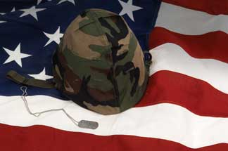



Pledge of Allegiance

Slide 4
Training Outline
Answers to the Test
Color Corps Overview
Proper 4th Degree Color Corps Attire
Color Corps Appearance
Conditioning Your Beret
Proper Protocol
Supreme Directives
Questions?

Slide 5
Color Corps Test
General Knowledge True False
The Commander is appointed by the Navigator and serves
during the Navigator’s term in office. ✓
The Marshal is appointed by the District Master and serves
until such time the Marshal decides to resign. ✓
When multiple Commanders are present at an event, the
Commanders take turns in hosting the event. ✓
When a Marshal is present at a Council or Assembly event,
the Marshal is automatically in charge of the Color Corps. ✓
The Commander is responsible for ensuring that the Color
Corps are in compliance to Supreme’s directives and the
Color Corps manual. ✓
The Commander/Marshal is responsible to ensure that the
District Deputy is following protocol when there is a procession
of dignitaries going into Church. ✓

Slide 6
Color Corps Test
General Knowledge – cont. True False
When Color Corps are lined up, the highest ranking officer is
placed at the front of the right column. ✓
The Color Corps are lined up shorted to highest for each rank. ✓

Slide 7
Color Corps Test
Proper Protocol for Color Corps Processions
When marching into Church at a District wide event, what is the proper line-up for the Color Corps? (number them 1 – 11 first to last entering church)
  Commanders (purple patch) 8
Former Masters (gold patch) 7
Former Vice Supreme Master (light blue patch) 5
Honor Guard (no patch) 11
Marshals (dark green patch) 3
Master (gold patch) 6
Navigators (white patch) 9
Sr. Marshal (dark green patch) 1
Past Faithful Navigators (white patch) 10
Supreme Master (dark blue patch) 2
Vice Supreme Master (light blue patch) 4

Slide 8
Color Corps Test
Proper Protocol for Color Corps Processions
When marching into Church at a District wide event, what is the proper line-up for the Color Corps? (number them 1 – 11 first to last entering church)
Sr. Marshal (dark green patch) 1
Supreme Master (dark blue patch) 2
Marshals (dark green patch) 3
Vice Supreme Master (light blue patch) 4
Former Vice Supreme Master (light blue patch) 5
Master (gold patch) 6
Former Masters (gold patch) 7
Commanders (purple patch) 8
Navigators (white patch) 9
Past Faithful Navigators (white patch) 10
Honor Guard (no patch) 11

Slide 9
Color Corps Test
Proper Protocol for Processions
When processing into Church for a Corporate Communion, what is the proper line-up for the dignitaries? (number them 1 – 14 first to last entering church)
Bishop 14
Candle Bearers 3
Color Corps 1
Council member 4
Council Officers 5
Cross Bearer 2 (CC not part of the literagy)
District Deputy 8
Grand Knight 6
District Master 9
Priests 13
State Deputy 12
State Directors 7
State Officers 10
Vice Supreme Master 11

Slide 10
Color Corps Test
Proper Protocol for Processions
When processing into Church for a Corporate Communion, what is the proper line-up for the dignitaries? (number them 1 – 14 first to last entering church)
Color Corps 1
Cross Bearer 2 (CC not part of the literagy)
Candle Bearers 3
Council member 4
Council Officers 5
Grand Knight 6
State Directors 7
District Deputy 8
District Master 9
State Officers 10
Vice Supreme Master 11
State Deputy 12
Priests 13
Bishop 14

Slide 11
Color Corps Test
Casket Watch True False
The Honor Guard does not have to be lead in by a M/CCC. ✓
Only 2 Honor Guards are used for a 4th Degree member and
4 Honor Guards are used for clergy. ✓
When CC is present, there will not be 4th Degree members
participating in the casket watch with the CC. ✓
When CC is not present, 4th Degree members may pay respect
to the deceased in pairs with like dress by standing watch at
the casket in the official 4th Degree attire, tuxedo or dark
suit with social baldric, no gloves. ✓
The deceased can wear the classic regalia. ✓

Slide 12
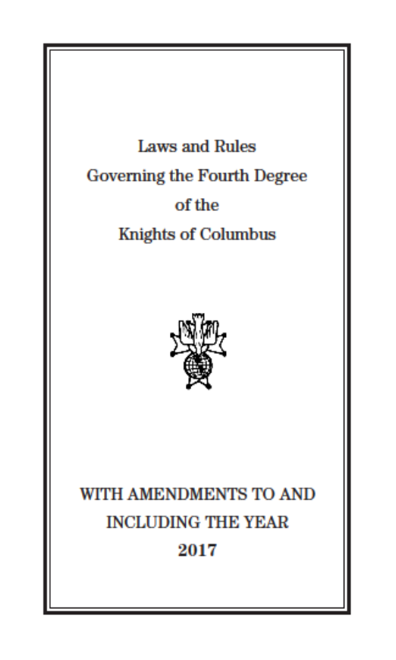
Color Corps Overview
ONLY the uniform has changed,
all the other procedures have not
Read & Study
Get a Copy
&
ORDER NUMBER 1350
ORDER NUMBER 808

Slide 13
4th Degree Hierarchy
Supreme Knight (Carl Anderson)
Supreme Master (Dennis Stoddard)
Vice Supreme Master (Clifford Wasmund, Fr. Hennepin Province)
District Master (Mark Brezenski, Michigan District 1)
Sacred Heart Assembly 2599 (Faithful Navigator, Rick Fisher)
Assigned Councils
(St. John Vianney, St. Therese of Lisieux, St. Isidore, St. Matthias)

Slide 14
Color Corps Overview – cont.
Provincial Marshal is appointed by the Vice Supreme Master
District Marshals are appointed by the District Master
Commander is appointed by the Faithful Navigator
Provincial Marshal, Marshal(s) and Commander’s term is for the Term of Office of the VSM, Master and Navigator respectively
Whenever two or more Assemblies are assigned to an event within the District, the District Marshal shall be in command
Whenever possible, and prior to the event, the attending CC should be inspected by the Commander at a minimum

Slide 15
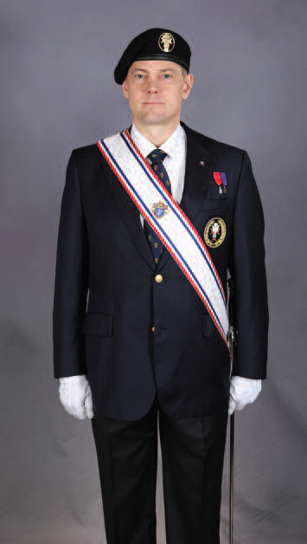
4th Degree Color Corps Attire
Official Navy Blue Blazer with 4th Degree Emblem Blazer Crest
Official 4th Degree Gray Pants, straight leg, “NO” cuffs
Official 4th Degree Necktie, (now available in extra long)
Official 4th Degree Black Beret with 4th Degree Metal Badge with appropriate color patch under badge
Plain Full Collar White Dress Shirt, Button Cuffs (no French cuffs, no button down collar or short sleeve shirt)
Black Socks and Plain Black “Polished” Shoes
Official 4th Degree Lapel Pin PG-113
Incumbent Medal of Office
Past and Former miniature medals above left pocket (1/4” above pocket)
Service Baldric and Sword
White Gloves
Name badge “IS NOT” to be worn when wearing the Uniform

Slide 16
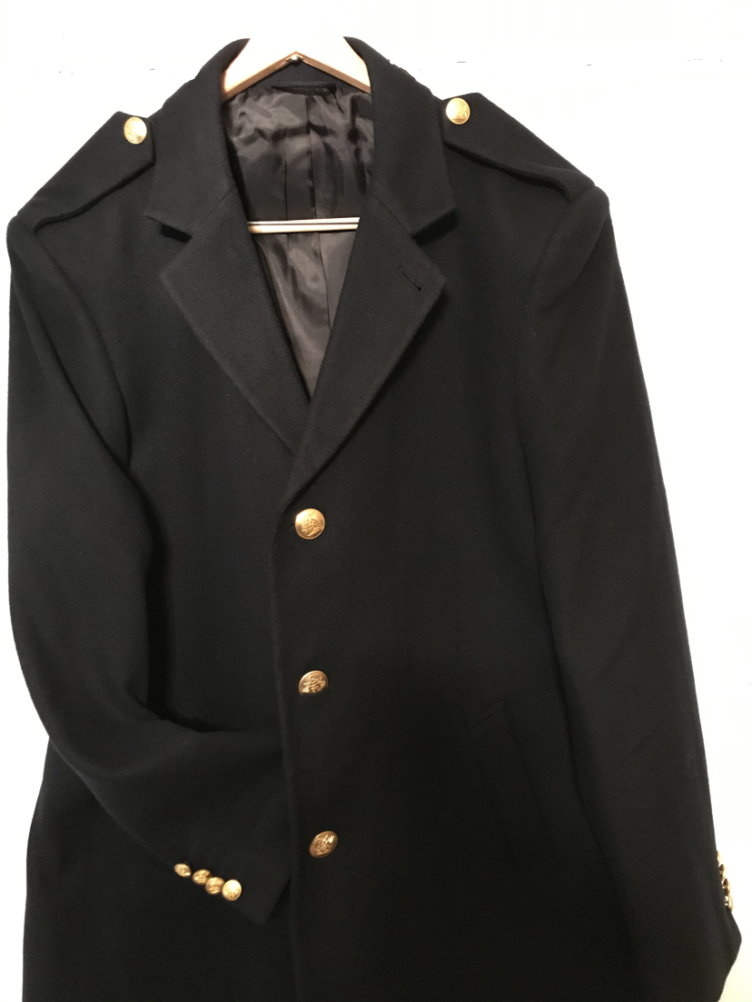
4th Degree Color Corps Attire
Newly Released Top Coat
Supplied by “The Supply Room” (833) 562-4327
Availability: November 23, 2019
Price: $225.00
Material: Full cut 100% light weight wool
Color: Same as the Uniform Blazer
4th Degree buttons
4th Degree lapel Pin (PG-113) to be located in the button hole on the lapel

Slide 17
Color Corps Appearance
  Baldric
    Emblem should be vertical to ground
    Proper length
    Stain free
  Swords
    Black handle for all except Navigators, Masters and Vice Supreme Masters
    White handle for Current and Former Navigators, Masters and Vice Supreme Masters
    White handle gold plated for Current and Former Masters and Vice Supreme Masters

Slide 18
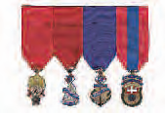
Color Corps Appearance
  Gloves
    Stain free / clean
    Good source to obtain free gloves: funeral homes
  Jewels of Office
    Master, Marshal, District Deputy, 3rd and 4th Degree Officers “currently” in office, are allowed to wear their jewels
    Jewels of Past/Former Officers “are not” allowed to be worn
    Miniature jewels of office are “allowed” to be worn with the regalia above the pocket
Former Master
Past Faithful Navigator
Former District Deputy
Past Grand Knight

Slide 19
Color Corps Appearance
The general public associates the Knights of Columbus with how the Color Corps presents themselves at events. If we look professional, then the Order is perceived as professional
Does your Uniform fit properly?
Is your beret on properly or is it the correct size?
Are your pockets empty?
Are your shoes shined?
Are you wearing clean white gloves and service baldric?
We all have an obligation to look after each other!

Slide 20
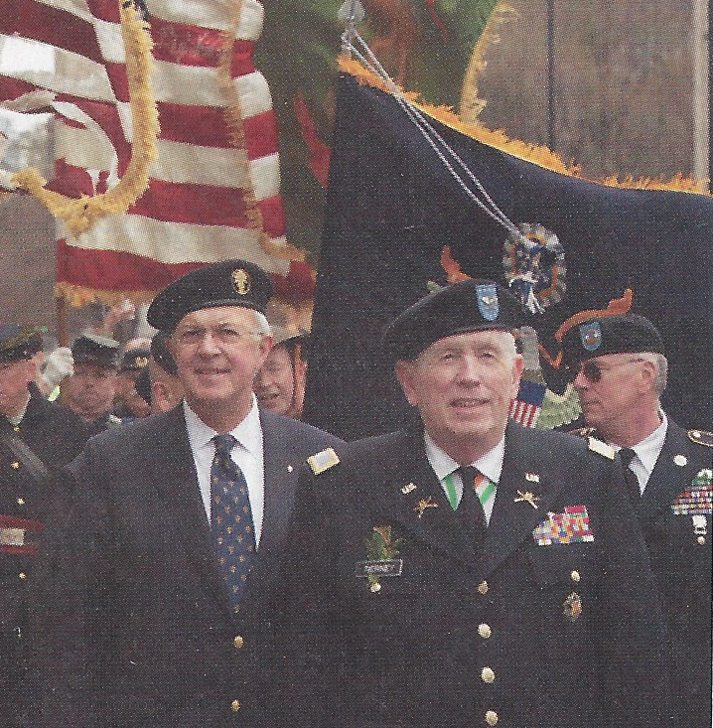
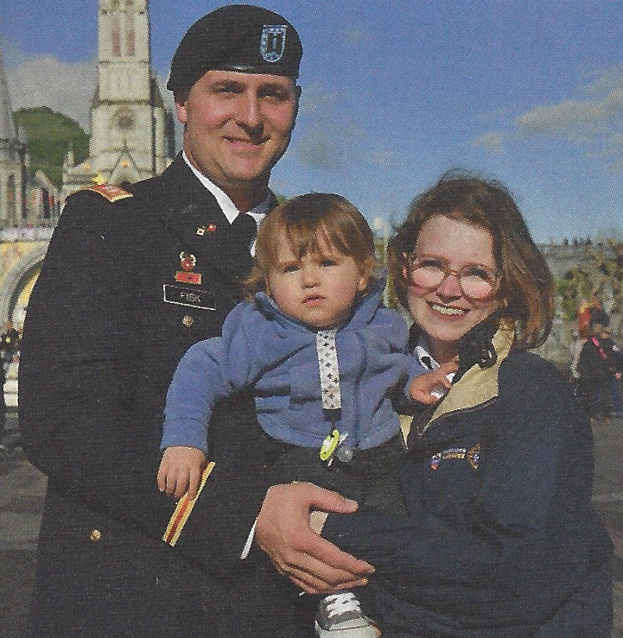
Color Corps Appearance
4th Degree Emblem is not over the SK Carl Anderson’s left eye
The military Emblem is over the left eye and beret cover the top of the right ear

Slide 21
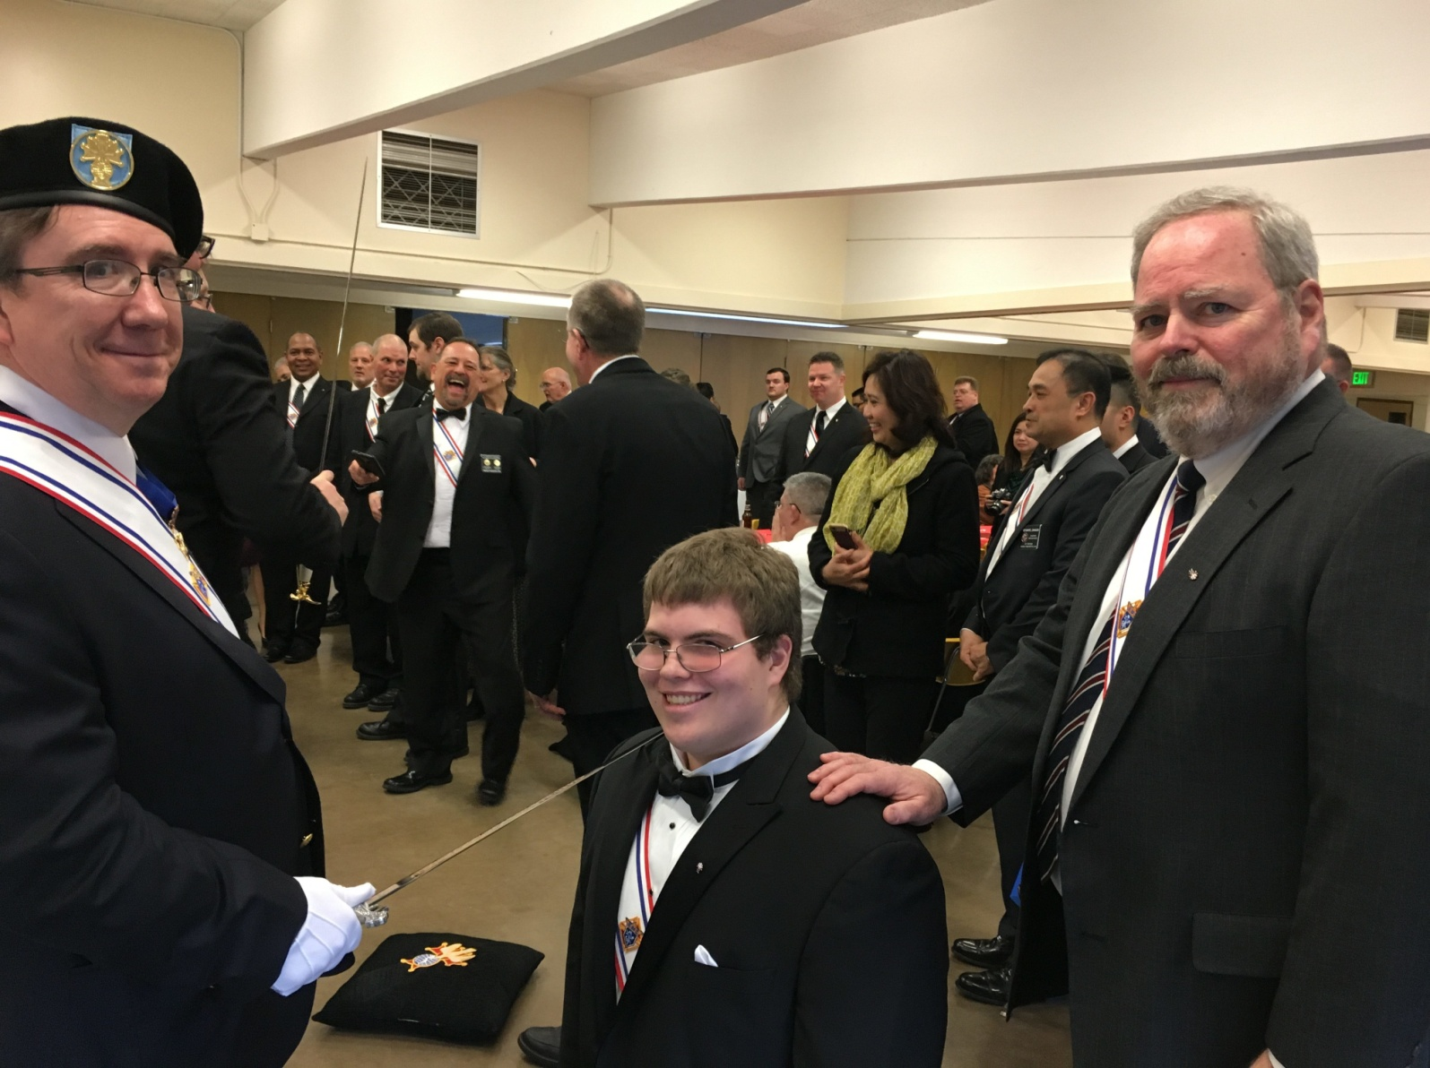
Color Corps Appearance
The 4th Degree Emblem/Patch is over the VSM’s right eye, “WRONG”

Slide 22
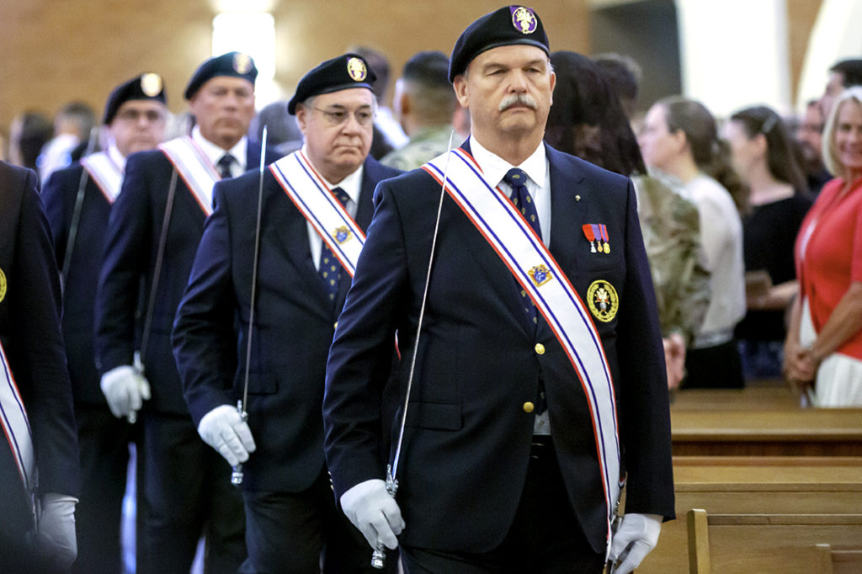
Color Corps Appearance

Slide 23
Proper Protocol
Alignment of Honor Guard
  Sr. Marshal (dark green patch)
  Supreme Master (dark blue patch)
  Vice Supreme Master and Former VSM (light blue patch)
  Master and Former Masters (gold patch)
  Marshals (dark green patch)
  Commanders (purple patch)
  Navigators and Past Faithful Navigators (white patch)
  Honor Guard (no patch)
    Short to tall, current to former (front to rear)

Slide 24
Proper Protocol
  6 each of the 4th Degree pin (PG-113)*
  Sewing kit (traveling kit)*
  Permanent black dry marker (cover up scratches on black handle swords)
  Breakfast bars for diabetic
  Color Corps Drill Manual (Catalog Item #808, Rev 1-18)*
  Protocol Handbook (Catalog Item #1612)*
  U.S. Flag Manual (Catalog Item #4686)*
  * Cost should be picked up by the Assembly

Slide 25
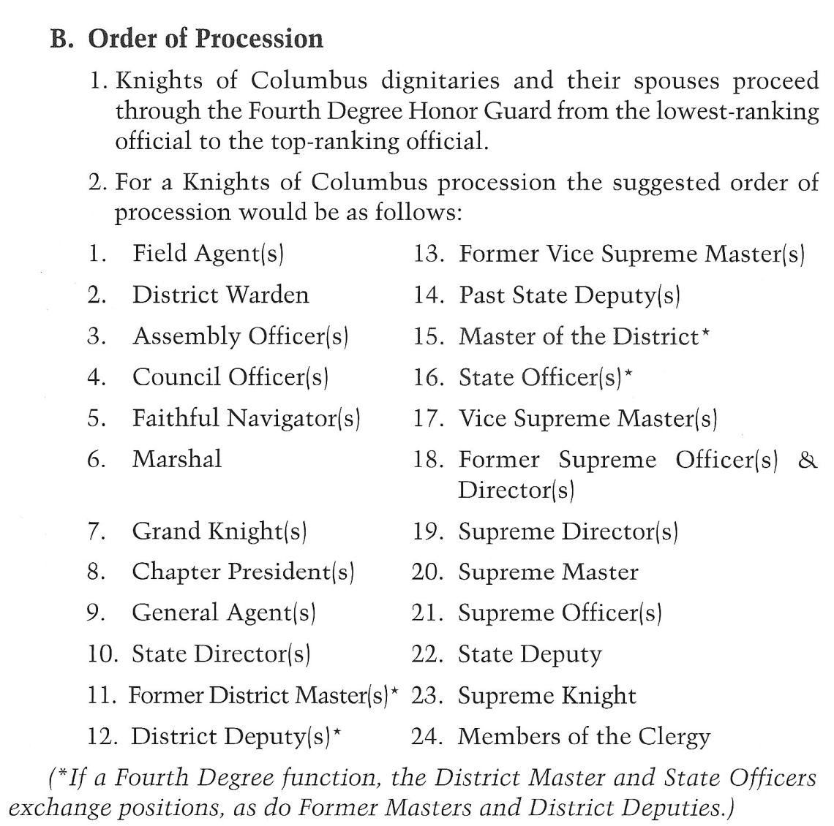
Proper Protocol
The Provincial Marshal, District Marshal or Commander should ensure that the proper protocol for the procession into Church or a banquet hall is followed per the CC Drill Manual or Protocol Handbook

Slide 26
Supreme Directives
The “Classic Regalia is retired effective July 1, 2019.
The PG113 pin is the only pin allowed to be worn on the Uniform.
We obey our Priests. Any member who is refused entry into Church because he is in the Uniform should obey the Priest. The District Master should be contacted. The District Master will make the determination if the Diocesan Bishop should be contacted to discuss this incident and the refusal of the Sacraments over an article of clothing.
The “Classic Regalia” cannot be worn at a Casket Watch. The deceased may wear his “Classic Regalia” if the family so wishes.
Social Baldric is worn over the tie when wearing a suit.

Slide 27
Supreme Directives – cont.
Social baldric is never worn with the Uniform
The colored beret patch can be procured from “The Supply Room” by sending an email to: https://www.kofcuniform.com
The beret is placed underneath the belt on the right side between the first belt loop and your pants pocket when you are not wearing it
The 4th Degree Ceremony Team members should all wear the same color business suit or new Uniform when the robes are no longer being used. Supreme is considering sometime in the distant future that all team members will be required to wear the Uniform, but not mandatory at this time

Slide 28
Supreme Directives – cont.
Casket Watch Guidelines
When CC is present, there will NOT be 4th Degree member participating in the casket watch with the CC
When CC is not present, 4th Degree members may pay respect to the deceased in pairs with like dress by standing watch at the casket in the official 4th Degree attire, tuxedo or dark suit with social baldric, no gloves

Slide 29
Supreme Directives – cont.
Classic Regalia Infraction
  Uniform Policy issued by SM in June 5, 2019 memo
    FNs were notified by their District Master as to this policy
    FIRST OFFENSE: Color Corpsman will be denied participation in the event and given written notification
    SECOND OFFENSE: Color Corpsman will be denied participation for the balance of the year and receive a second written notification with copies to FN, VSM and SM
    THIRD OFFENSE: Color Corpsman may receive a summary suspension
    Master or FN that cannot comply with this policy should contact the SM
    FN shall remove the CCC who refuses to follow this policy

Slide 30
Supreme Directives – cont.

Slide 31
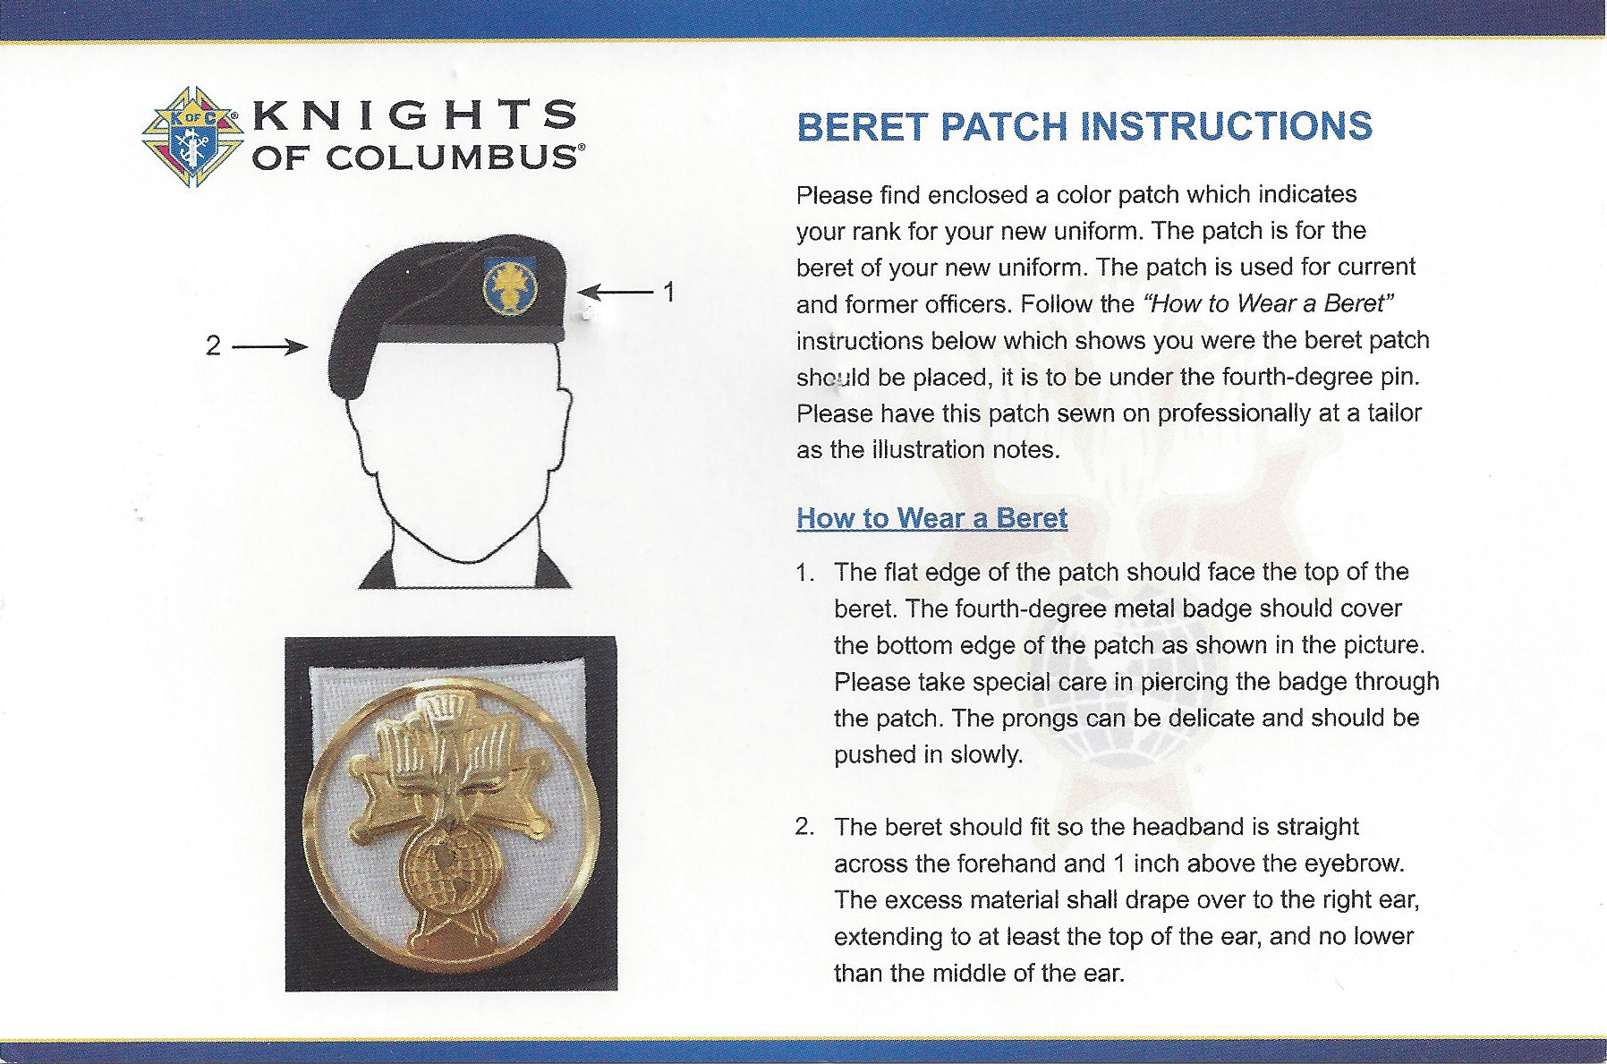
Conditioning Your Beret

Slide 32
Conditioning Your Beret
Tie the adjustment string into a square knot once you have the correct size
Slip the string into the bead with either a pen cartridge or large paper clip
Cut out the inside lining (it will help the beret to lay correctly and keep your head cooler). Berets purchased from TSR do not have a lining
Submerge the beret in warm water so that it is thoroughly soaked
Wring out the water and place beret on your head with the stiff flap over your left eye
With your left hand, hold the left edge of the beret at ear height
With your right hand, grab the right side of the beret and pull down and stretching it over your right ear and form the beret over the top of your head
Refer to the you tube video link below: https://www.youtube.com/watch?v=LA7mYjycgFs or https://www.wikihow.com/Shape-a-Beret

Slide 33
Marshal, Commander Appointments
Provincial
  Vice Supreme Master appoints Provincial Marshal(s)
District
  District Master appoints District Marshal(s)
Assembly
  Faithful Navigator appoints Color Corps Commander
The Marshal and Commander serve under the discretion of the VSM, DM and FN during his term in office

Slide 34
Inspection of the Color Corps
When
Prior to every assignment
Who performs the Inspection
Assembly
  The Faithful Navigator with the Color Corps Commander
District
  The Master with the District Marshal(s)
Province
  The Vice Supreme Master with Provincial Marshal and District Masters (District Marshals may participate at the direction of the Vice Supreme Master)

Slide 35
Giving Commands
Two types of Commands , Silent and Verbal
All Commands have two parts
Verbal Commands must be clear and loud so all may hear and understand
SILENT COMMAND – DRAW SWORD
M/CCC raises his right hand for all to see, then lowers it and grabs the sword handle
Once the M/CCC visually confirms all HG have their hand on the sword handle, the M/CCC draws the sword out of the scabbard to the carry sword position

Slide 36
Giving Commands
VERBAL COMMAND – DRAW SWORD
The first word is the action to be taken (DRAW) hand is placed on sword
The second word is the execution of the command (SWORD) the sword is drawn from scabbard to the carry position

Slide 37
Mass Procedures
Procession into Church with Swords
  Upon reaching the front of the Church, the M/CCC salutes the alter, center faces, thus signaling for all Honor Guard to center face
  The M/CCC turns left or right, takes a step back, and together go to “Present Swords” or hand salute when swords are not used
  After the priest passes the M/CCC, the M/CCC takes one step forward and goes to carry swords, thus signaling the Honor Guard to go to “Carry Swords”
  The M/CCC and Honor Guard front face in unison.
  The M/CCC takes a step forward, thus signaling the Honor Guard to process forward, across the front to their respective side aisle, to the rear of the Church and behind the back pew and stop at the center isle*
  The M/CCC instructed the Honor Guard to return swords, and remove beret with silent commands and enters pew from the center aisle*

Slide 38
Mass Procedures
Offertory – Presentation of Gifts
  M/CCC selects Honor Guard members from that church is preferred
  Honor Guard need to agree between themselves on how many steps they
  will make across the front to allow sufficient space for the gift bearers
  M/CCC escorts gift bearers from pews to back of the church (usually State
  Officers or special occasions)
  Honor Guard processes up the center aisle escorting gift bearers to the
  Priest (4 HG are used, 2 front, 2 behind for State Officers)
  Honor Guard moves across front, does an about face, “Presents Swords”
  while gifts are presented
  Honor Guard go to “Carry Swords” when gift bearers return to their seats
  Honor Guard approach each other, turn and bow to the altar
  Honor Guard does an about face (rotate right); return down center aisle
  At the back of Church, the Honor Guard return their swords, remove their
  beret and returns to their pew in unison

Slide 39
Mass Procedures
Communion
  After the “Great Amen”, the M/CCC moves to the center isle and
  signals to the Honor Guard to remove their Chapeau and gloves
  At the appropriate time, the Honor Guards leave their pews from
  the side aisle and line up behind the last row of pews on each
  side
  The Honor Guard proceed down the center with the right hand over
  their heart and the left hand holding their sword*
  Communion can be taken by hand or mouth
  If not taking the blood of Christ, the Honor Guard should bow in
  reverence and stay in order
  After the ciborium is placed in the tabernacle, the M/CCC moves
  to the center isle and signals to the Honor Guard to put their
  gloves on*

Slide 40
Mass Procedures
Recession out of Church
  The M/CCC instructs the Honor Guard to leave their pews and line up behind the last pew
  The M/CCC instructs the Honor Guard to put their beret on and “Draw Swords” and proceeds down the center aisle*
  Upon reaching the front of the church, the M/CCC leaves enough room for the cross, candle bearers and the priest
  When the priest turns to the rear of the church, the M/CCC does an about face, thus signaling the Honor Guard to center face and “Present Swords”
  As the M/CCC proceeds to the rear of the church and goes past the first two Honor Guards, they go to “Carry Swords” and in turn proceed to the rear of the church (if aisle is too small, the Honor Guard on the right (as you face the front of the church) will take the lead and follow M/CCC
  This is repeated by the remaining Honor Guards

Slide 41


Mass Recessional
With a
“Wide” Center Aisle

Slide 42
ALTAR
All are at ‘Attention’ Position – “Carry Swords” Position
Facing the Altar, the M/CCC Leads HG Up Center Aisle

Slide 43
ALTAR

Slide 44
ALTAR

Slide 45
ALTAR
Property of Michigan District #1 - Reproduction Prohibited Without Written Permission

Slide 46
ALTAR
Property of Michigan District #1 - Reproduction Prohibited Without Written Permission

Slide 47
ALTAR
Property of Michigan District #1 - Reproduction Prohibited Without Written Permission

Slide 48
ALTAR
Property of Michigan District #1 - Reproduction Prohibited Without Written Permission

Slide 49
ALTAR
Property of Michigan District #1 - Reproduction Prohibited Without Written Permission

Slide 50
ALTAR
As Celebrant Kisses the Altar
M/CCC Salutes the Altar
Property of Michigan District #1 - Reproduction Prohibited Without Written Permission

Slide 51
ALTAR
The M/CCC does an ‘About Face’
Remaining CC Face Inward, and ‘Present Swords’
Property of Michigan District #1 - Reproduction Prohibited Without Written Permission

Slide 52
ALTAR
M/CCC ONLY Goes to ‘Carry Sword’
M/CCC Begins to March Between the Ranks

Slide 53
ALTAR
As the M/CCC Passes Each Pair of HG,
They (IN PAIRS) go to ‘Carry Sword’

Slide 54
ALTAR
They (IN PAIRS) Take One Step Forward
Property of Michigan District #1 - Reproduction Prohibited Without Written Permission

Slide 55
ALTAR
They (IN PAIRS) ‘Face Rear’
Property of Michigan District #1 - Reproduction Prohibited Without Written Permission

Slide 56
ALTAR
Then Follow the M/CCC and March Out of Church
As Each Pair Passes Through,
The Next Pair Repeat the Same Process
Property of Michigan District #1 - Reproduction Prohibited Without Written Permission

Slide 57
ALTAR
‘Carry Sword’ and One Step Forward
Property of Michigan District #1 - Reproduction Prohibited Without Written Permission

Slide 58
ALTAR
Face Rear
Follow the Recessional
Property of Michigan District #1 - Reproduction Prohibited Without Written Permission

Slide 59
ALTAR
‘Carry Sword’ and One Step Forward
Property of Michigan District #1 - Reproduction Prohibited Without Written Permission

Slide 60
ALTAR
Face Rear and Follow the Recessional
Property of Michigan District #1 - Reproduction Prohibited Without Written Permission

Slide 61
ALTAR
‘Carry Sword’ and One Step Forward
Property of Michigan District #1 - Reproduction Prohibited Without Written Permission

Slide 62
ALTAR
Face Rear and Follow the Recessional
Property of Michigan District #1 - Reproduction Prohibited Without Written Permission

Slide 63
ALTAR
Property of Michigan District #1 - Reproduction Prohibited Without Written Permission

Slide 64
ALTAR
Property of Michigan District #1 - Reproduction Prohibited Without Written Permission

Slide 65
ALTAR
Property of Michigan District #1 - Reproduction Prohibited Without Written Permission

Slide 66
ALTAR
Property of Michigan District #1 - Reproduction Prohibited Without Written Permission

Slide 67
ALTAR
Property of Michigan District #1 - Reproduction Prohibited Without Written Permission

Slide 68
Mass Recessional
With a
“Narrow” Center Aisle

Slide 69
ALTAR
All are at ‘Attention’ Position – Swords NOT Drawn
Facing the Altar, the M. or C.C.C. Leads CC Up Center Aisle
Property of Michigan District #1 - Reproduction Prohibited Without Written Permission

Slide 70
ALTAR
Property of Michigan District #1 - Reproduction Prohibited Without Written Permission

Slide 71
ALTAR
Property of Michigan District #1 - Reproduction Prohibited Without Written Permission

Slide 72
ALTAR
Property of Michigan District #1 - Reproduction Prohibited Without Written Permission

Slide 73
ALTAR
Property of Michigan District #1 - Reproduction Prohibited Without Written Permission

Slide 74
ALTAR
Property of Michigan District #1 - Reproduction Prohibited Without Written Permission

Slide 75
ALTAR
Property of Michigan District #1 - Reproduction Prohibited Without Written Permission

Slide 76
ALTAR
Property of Michigan District #1 - Reproduction Prohibited Without Written Permission

Slide 77
ALTAR
As Celebrant Kisses the Altar, M. or C.C.C. Signals ‘Draw Sword’
Then ONLY the M. or C.C.C. Salutes the Altar
Property of Michigan District #1 - Reproduction Prohibited Without Written Permission

Slide 78
ALTAR
The M. or C.C.C. does an ‘About Face’
Remaining CC Face Inward, M. or C.C.C. Signals ‘Present Sword’
Property of Michigan District #1 - Reproduction Prohibited Without Written Permission

Slide 79
ALTAR
M. or C.C.C. ONLY Goes to ‘Carry Sword’
M. or C.C.C. Begins to March Between the Ranks
Property of Michigan District #1 - Reproduction Prohibited Without Written Permission

Slide 80
ALTAR
As the M. or C.C.C. Passes Each Pair of CC, They (IN PAIRS) go to ‘Carry Sword’
Property of Michigan District #1 - Reproduction Prohibited Without Written Permission

Slide 81
ALTAR
This Part of the Recessional Needs to be Done SINGLE File
The Right Column (as Facing the Altar) Will Proceed First
Property of Michigan District #1 - Reproduction Prohibited Without Written Permission

Slide 82
ALTAR
One Step Forward, Lined Up Directly Behind the M. or C.C.C.
Property of Michigan District #1 - Reproduction Prohibited Without Written Permission

Slide 83
ALTAR
Face Rear and Follow
Property of Michigan District #1 - Reproduction Prohibited Without Written Permission

Slide 84
ALTAR
The Left Side, One Step Forward
Property of Michigan District #1 - Reproduction Prohibited Without Written Permission

Slide 85
ALTAR
Face Rear and Follow
Property of Michigan District #1 - Reproduction Prohibited Without Written Permission

Slide 86
ALTAR
Property of Michigan District #1 - Reproduction Prohibited Without Written Permission

Slide 87
ALTAR
Property of Michigan District #1 - Reproduction Prohibited Without Written Permission

Slide 88
ALTAR
Property of Michigan District #1 - Reproduction Prohibited Without Written Permission

Slide 89
ALTAR
Property of Michigan District #1 - Reproduction Prohibited Without Written Permission

Slide 90
ALTAR
Property of Michigan District #1 - Reproduction Prohibited Without Written Permission

Slide 91
ALTAR
Property of Michigan District #1 - Reproduction Prohibited Without Written Permission

Slide 92
ALTAR
Property of Michigan District #1 - Reproduction Prohibited Without Written Permission

Slide 93
ALTAR
Property of Michigan District #1 - Reproduction Prohibited Without Written Permission

Slide 94
ALTAR
Property of Michigan District #1 - Reproduction Prohibited Without Written Permission

Slide 95
ALTAR
Property of Michigan District #1 - Reproduction Prohibited Without Written Permission

Slide 96
ALTAR
Property of Michigan District #1 - Reproduction Prohibited Without Written Permission

Slide 97
ALTAR
Property of Michigan District #1 - Reproduction Prohibited Without Written Permission

Slide 98
ALTAR
Property of Michigan District #1 - Reproduction Prohibited Without Written Permission

Slide 99
ALTAR
Property of Michigan District #1 - Reproduction Prohibited Without Written Permission

Slide 100
ALTAR
Property of Michigan District #1 - Reproduction Prohibited Without Written Permission

Slide 101
ALTAR
Property of Michigan District #1 - Reproduction Prohibited Without Written Permission

Slide 102
ALTAR
Property of Michigan District #1 - Reproduction Prohibited Without Written Permission

Slide 103
ALTAR
Property of Michigan District #1 - Reproduction Prohibited Without Written Permission

Slide 104
Casket Watch

Slide 105
Casket Watch
What Assembly does the deceased belong to?
Notify that Assembly’s Navigator. They are the Host Assembly.
If the ceremonials are to be held at a location outside of the Host Navigators area, the Host Navigator notifies the appropriate Navigator. The Host Navigator retains responsibility for coordinating the event.
The Host Navigator, local Navigator and local Commander work together on the details.

Slide 106
Casket Watch
Marshal/Commander to review layout of parlor
Marshal/Commander leads with 2 Honor Guards in a formation conducive to the layout of the parlor
Marshal/Commander stops in front of casket, forward face and takes one step back or forward dependent upon space
The first Honor Guard proceeds to the other side of the Marshal/Commander leaving enough space for another Honor Guard. Marshal/Commander steps forward or back
All three salute and the Honor Guards proceeds to their designated locations at each end of the casket
Marshal/Commander salutes and exits parlor
Together the Honor Guards goes “Carry Swords” position and remain in this position until the replacement Honor Guards arrive

Slide 107
Casket Watch
Marshal/Commander returns with two replacement Honor Guard
Honor Guards at casket go to carry swords if at mourner’s rest
Marshal/Commander stops in front of casket, forward face and takes one step back or forward dependent upon space
The first Honor Guard proceeds to the other side of the Marshal/Commander leaving enough space for another Honor Guard. Marshal/Commander steps forward or back
The Honor Guards on watch will take one step towards each other and move to the positions between the Marshal/Commander and new Honor Guards and about face
The Commander and Honor Guards will present swords (hold for 2-3 seconds) and go to carry swords. The new Honor Guards will assume their position at the casket.
The Marshal/Commander and relieved Honor Guard will exit the room

Slide 108
Casket Watch
At the end of the Watch, the Honor Guard remove regalia and proceed into parlor and stands in front of casket where they say their final prayers
For clergy, four guards will be used at the casket during the Watch
At such time when there an over-abundance of Honor Guards, it is suggested that four guards be used to ensure that all in attendance will have an opportunity to pay their respects by standing watch.

Slide 109
Casket Watch, Church Etiquette
Casket Watch – Same procedure to be followed as at the funeral home
Mass – Same procedure to be followed
After Mass - The Honor Guards shall march from the Church to the hearse forming an aisle. Upon the Commander’s direction the Honor Guards will lay the tip of their sword on the casket and say on final pray. After the prayer the HG go to “Present Swords”
Cemetery – Procedures depend on family wishes; when all attendants dismissed, Honor Guard place tip of swords on casket and say prayer
NOTE: Ensure family of deceased Sir Knight is consulted with regards to their wishes, contact the Priest bout the use of swords, and the Funeral Director about one final prayer by the CC prior to the casket being placed in the hearse

Slide 110
Posting the Honor Guards

Slide 111
Casket
All are at ‘Carry Sword’ Position
Commander leads in the watch.
Property of Michigan District #1 - Reproduction Prohibited Without Written Permission

Slide 112
Casket
All are at ‘Carry Sword’ Position
Commander leads in the watch in single file.

Slide 113
Casket
All are at ‘Carry Sword’ Position
Commander leads in the watch in single file.
Property of Michigan District #1 - Reproduction Prohibited Without Written Permission

Slide 114
Casket
All are at ‘Carry Sword’ Position
Commander leads in the watch in single file.
Property of Michigan District #1 - Reproduction Prohibited Without Written Permission

Slide 115
Casket
All are at ‘Carry Sword’ Position
Commander leads in the watch in single file.
Property of Michigan District #1 - Reproduction Prohibited Without Written Permission

Slide 116
Casket
All are at ‘Carry Sword’ Position
Commander leads in the watch in single file.
Property of Michigan District #1 - Reproduction Prohibited Without Written Permission

Slide 117
Casket
All are at ‘Carry Sword’ Position
Commander leads in the watch in single file.
Property of Michigan District #1 - Reproduction Prohibited Without Written Permission

Slide 118
Casket
All are at ‘Carry Sword’ Position
Commander leads in the watch in single file.
Property of Michigan District #1 - Reproduction Prohibited Without Written Permission

Slide 119
Casket
All are at ‘Carry Sword’ Position
Commander leads in the watch in single file.
Property of Michigan District #1 - Reproduction Prohibited Without Written Permission

Slide 120
Casket
All are at ‘Carry Sword’ Position
Commander leads in the watch in single file.
Property of Michigan District #1 - Reproduction Prohibited Without Written Permission

Slide 121
Casket
All are at ‘Carry Sword’ Position
Commander stops in front of casket leaving room for maneuvering
Property of Michigan District #1 - Reproduction Prohibited Without Written Permission

Slide 122
Casket
All are at ‘Carry Sword’ Position
Commander will ‘right face’
Property of Michigan District #1 - Reproduction Prohibited Without Written Permission

Slide 123
Casket
All are at ‘Carry Sword’ Position
Commander takes one step forward or backward (space dictating)
Property of Michigan District #1 - Reproduction Prohibited Without Written Permission

Slide 124
Casket
All are at ‘Carry Sword’ Position
First guard moves forward, second guard remains still
Property of Michigan District #1 - Reproduction Prohibited Without Written Permission

Slide 125
Casket
All are at ‘Carry Sword’ Position
First guard moves forward, second guard remains still
Property of Michigan District #1 - Reproduction Prohibited Without Written Permission

Slide 126
Casket
All are at ‘Carry Sword’ Position
Commander takes one step back
First guard stops leaving the same distance from the Commander as the second guard
Property of Michigan District #1 - Reproduction Prohibited Without Written Permission

Slide 127
Casket
All are at ‘Carry Sword’ Position
Both guards ‘right face’ and at the Commander’s signal
All three ‘present swords’ simultaneously
Property of Michigan District #1 - Reproduction Prohibited Without Written Permission

Slide 128
Casket
All are at ‘Carry Sword’ Position
The Commander will say ‘Post’ and the two guards will move into position at the casket.
Property of Michigan District #1 - Reproduction Prohibited Without Written Permission

Slide 129
Casket
All are at ‘Carry Sword’ Position
The two guards face each other and assume “mourner’s rest” position.
Property of Michigan District #1 - Reproduction Prohibited Without Written Permission

Slide 130
Casket
Commander is at ‘Carry Sword’ and guards at “mourner’s rest”
Commander exits on the same path when he came in.
Property of Michigan District #1 - Reproduction Prohibited Without Written Permission

Slide 131
Casket
Commander is at ‘Carry Sword’ and guards at “mourner’s rest”
Commander exits on the same path when he came in.
Property of Michigan District #1 - Reproduction Prohibited Without Written Permission

Slide 132
Replacing the Honor Guards

Slide 133
Casket
Replacement watch is at ‘Carry Sword’ Position
Commander leads in the replacement watch.
Property of Michigan District #1 - Reproduction Prohibited Without Written Permission

Slide 134
Casket
Replacement watch is at ‘Carry Sword’ Position
Commander leads in the replacement watch.
Property of Michigan District #1 - Reproduction Prohibited Without Written Permission

Slide 135
Casket
Replacement watch is at ‘Carry Sword’ Position
Commander leads in the replacement watch.
Property of Michigan District #1 - Reproduction Prohibited Without Written Permission

Slide 136
Casket
Replacement watch is at ‘Carry Sword’ Position
Commander leads in the replacement watch. As the current watch sees their replacements, current watch goes to ‘Carry Swords’.
Property of Michigan District #1 - Reproduction Prohibited Without Written Permission

Slide 137
Casket
All are at ‘Carry Sword’ Position
Commander leads in the replacement watch.
Property of Michigan District #1 - Reproduction Prohibited Without Written Permission

Slide 138
Casket
All are at ‘Carry Sword’ Position
Commander leads in the replacement watch.
Property of Michigan District #1 - Reproduction Prohibited Without Written Permission

Slide 139
Casket
All are at ‘Carry Sword’ Position
Commander leads in the replacement watch.
Property of Michigan District #1 - Reproduction Prohibited Without Written Permission

Slide 140
Casket
All are at ‘Carry Sword’ Position
Commander leads in the replacement watch.
Property of Michigan District #1 - Reproduction Prohibited Without Written Permission

Slide 141
Casket
All are at ‘Carry Sword’ Position
Commander leads in the replacement watch.
Property of Michigan District #1 - Reproduction Prohibited Without Written Permission

Slide 142
Casket
All are at ‘Carry Sword’ Position
Commander stops in front of the casket
Property of Michigan District #1 - Reproduction Prohibited Without Written Permission

Slide 143
Casket
All are at ‘Carry Sword’ Position
Commander does a ‘right face’ then takes one step forward or backward
Property of Michigan District #1 - Reproduction Prohibited Without Written Permission

Slide 144
Casket
All are at ‘Carry Sword’ Position
First replacement guard moves forward, second guard remains still
Property of Michigan District #1 - Reproduction Prohibited Without Written Permission

Slide 145
Casket
All are at ‘Carry Sword’ Position
First replacement guard stops, Commander takes one step back
Property of Michigan District #1 - Reproduction Prohibited Without Written Permission

Slide 146
Casket
All are at ‘Carry Sword’ Position
Replacement guards “Left Face”
Guards on watch take one step towards each other
Property of Michigan District #1 - Reproduction Prohibited Without Written Permission

Slide 147
Casket
All are at ‘Carry Sword’ Position
Guards at watch “Left and Right Face” and join the line, between the Commander and their replacement
Property of Michigan District #1 - Reproduction Prohibited Without Written Permission

Slide 148
Casket
All are at ‘Carry Sword’ Position
After joining the line, the casket guards do an ‘about face’
At the Commander’s signal, all 5 Color Corps do a ‘present swords’
Property of Michigan District #1 - Reproduction Prohibited Without Written Permission

Slide 149
Casket
At the Commander’s signal to ‘carry swords’, the replacement guards go to their positions at the casket
Property of Michigan District #1 - Reproduction Prohibited Without Written Permission

Slide 150
Casket
As the replacement guards reach their positions at the casket,
They face each other and assume “mourner’s rest”
Property of Michigan District #1 - Reproduction Prohibited Without Written Permission

Slide 151
Casket
As the replacement guards reach their positions at the casket,
They face each other and assume “mourner’s rest”
Property of Michigan District #1 - Reproduction Prohibited Without Written Permission

Slide 152
Casket
The Commander takes one step back or forward then
All three do a ‘right face’
Property of Michigan District #1 - Reproduction Prohibited Without Written Permission

Slide 153
Casket
The Commander takes one step back then
All three do a ‘right face’
Property of Michigan District #1 - Reproduction Prohibited Without Written Permission

Slide 154
Casket
The Commander takes the lead position

Slide 155
Casket
The Commander leads the relieved watch out

Slide 156
Casket
The Commander leads the relieved watch out

Slide 157
Casket
The Commander leads the relieved watch out

Slide 158
Casket
The Commander leads the relieved watch out

Slide 159
Casket
The Commander leads the relieved watch out

Slide 160
Casket
The Commander leads the relieved watch out

Slide 161
Posting the Colors

Slide 162
Posting the Colors
Select Flag Bearers and Guards
Flag Bearers do not wear their sword
Vice Supreme/Master/Marshal instructs Commander to post Colors
American Flag led by a Color Guard proceeds down the aisle
Other flags follow behind in the following order:
  Canadian Flag (if applicable)
  Papal Flag
  State Flag
  K of C Flag

Slide 163
Posting the Colors
Guards and Flag Bearers line up at the front of the room facing the audience
American flag and its Guard take upon direction from their Commander right-face
The other Flag Bearers and Guard left-face at the same time
All proceed to the designated flag stands

Slide 164
#5 – Posting of the Colors
Commander instructs the Flag Bearers to post colors
  American Flag on left along with Canadian and Papal to the US flag’s right; all other flags on right of head table
US Canada Papal State KofC
Guards present swords and Flag Bearers salute American flag for 5 seconds or during the Pledge of Allegiance/National Anthem
Flag Bearers and Guards return to the front, all left/right-face upon the Commander’s command and proceed to their predetermined exit isle

Slide 165
Color Corps Request Form

Slide 166
Color Corps Request Form
Obtain latest version of the request form from the District website
Be sure to COMPLETELY fill out the form
Form is filled out by person responsible for the event (usually the GK)
Form is submitted to the appropriate Marshal via e-mail
Marshal approves and assigns Assembly Color Corps when appropriate
Approved copy sent back to the requestor, CC Commander and Navigator of Assembly(s) assigned

Slide 167
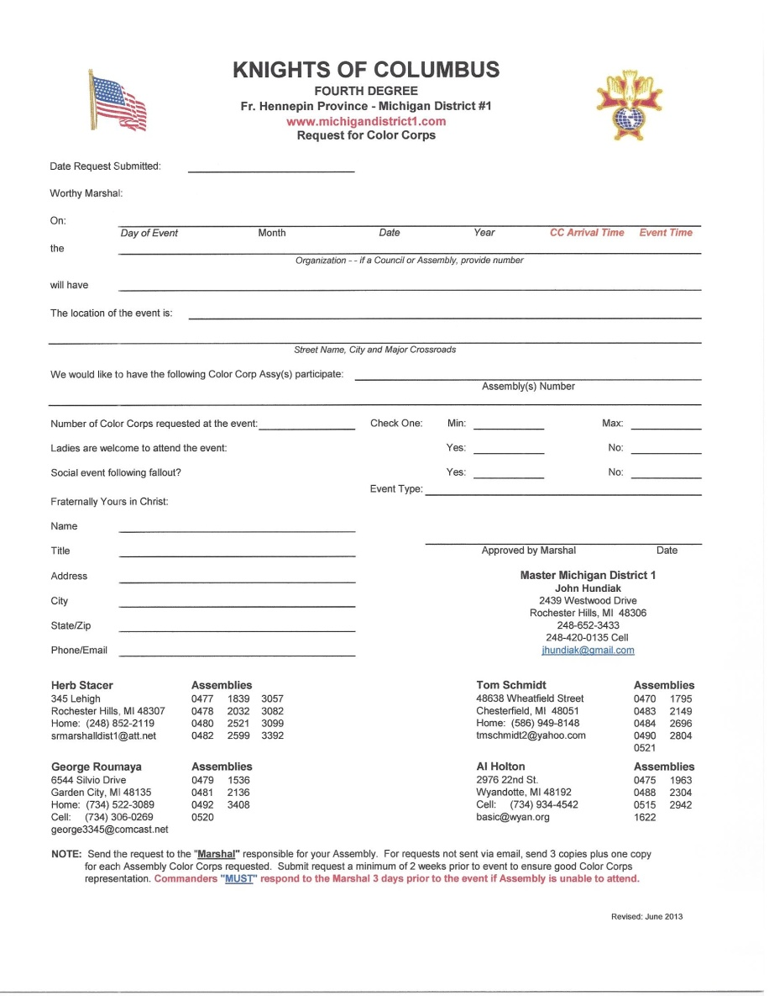
Color Corps Request Form

Slide 168
Color Corps Participation
Within District #1, incidences have occur when multiple Assemblies are assigned to an event and the Honor Guard from an Assembly either:
  Doesn’t show up
  Commander, Navigator or other individual takes it upon himself to determine if Color Corps will be notified of the assignment
  Only has 1 or 2 Color Corps show up from that Assembly
  Marshal was never notified by that Assembly Commander that they will not be represented or will have a minimum attendance of <3

Slide 169
Color Corps Participation
The Commander is responsible for:
  Notifying the Assembly CC of the assignment
  Determine the number of Corpsmen that will attend
  Notify the Marshal that his Assembly will not be represented or will have less than 3 in attendance
  Notification to the Marshal must take place a minimum of 3 days prior to the event
Navigators are responsible to ensure that his Commander is in compliance

Slide 170
Color Corps Participation
Three years ago the Commanders and Navigators collectively agreed to:
  Notify the Marshal that his Assembly will not be represented or will have less than 3 in attendance
  Notification to the Marshal must take place a minimum of 3 days prior to the event
  Failure to do this will result in an apology letter or e-mail written by the Commander to the CC requestor. If Commander refuses to write letter, Navigator will be required to write the letter
  THIS IS ONLY COMMON COURTESY!

Slide 171
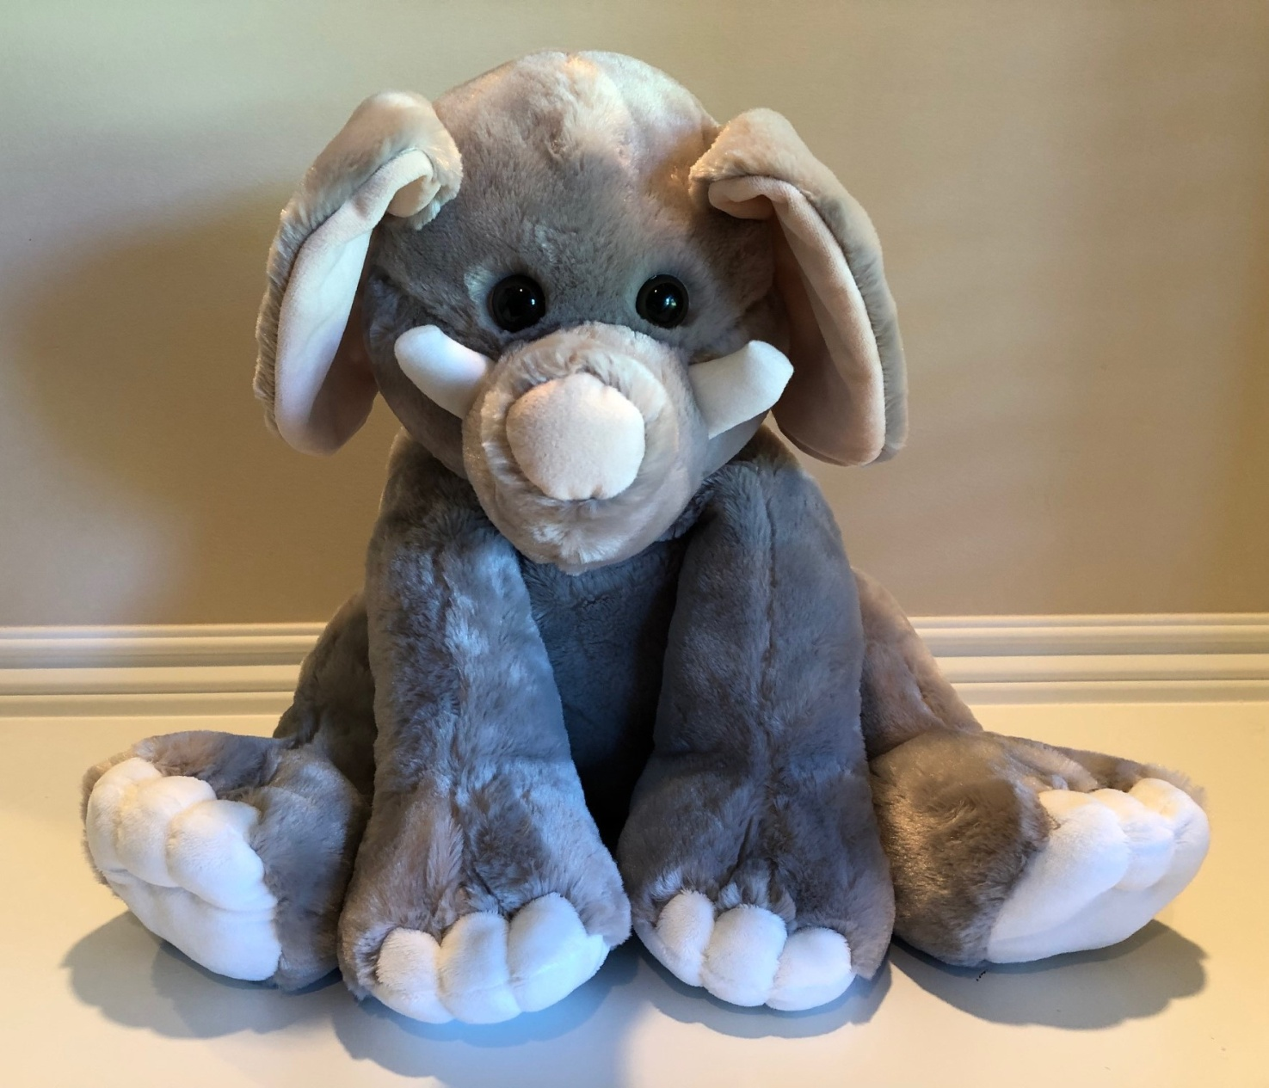
QUESTIONS?

