Slide 1
2019 Color Corps Training Provincial Meeting
Presented by:
FM John Hundiak

Slide 2
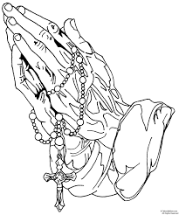
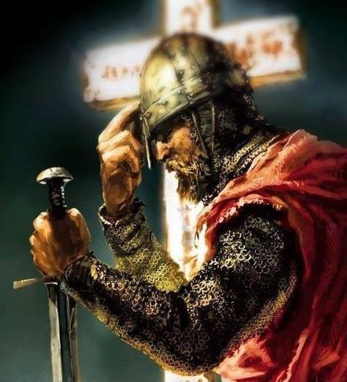
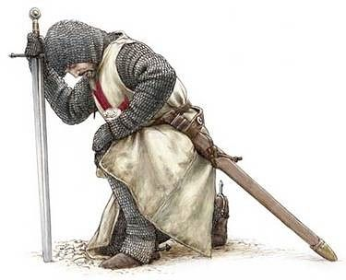
Opening Prayer

Slide 3
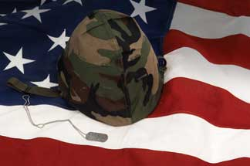
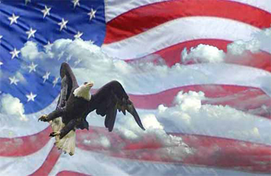
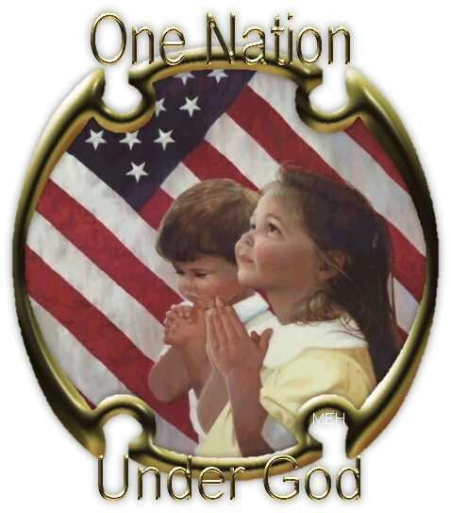
Pledge of Allegiance

Slide 4
Training Outline
Color Corps Overview
Proper 4th Degree Member Attire
Proper 4th Degree Color Corps Attire
Color Corps Appearance
Supreme Directives
Conditioning Your Beret
Questions?

Slide 5
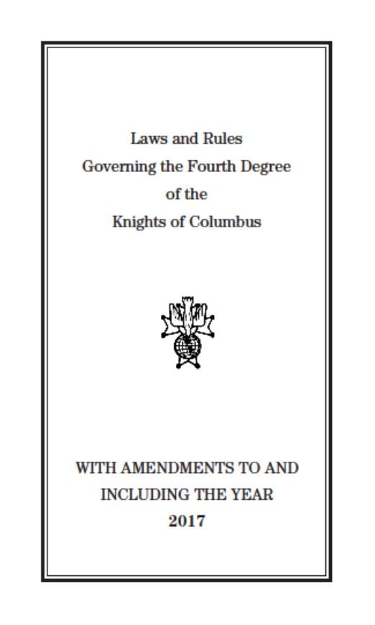
Color Corps Overview
ONLY the uniform has changed, all the other procedures have not
Get a Copy
Read & Study
&
ORDER NUMBER 1350
ORDER NUMBER 808

Slide 6
Color Corps Overview – cont.
Provincial Marshal is appointed by the Vice Supreme Master
District Marshals are appointed by the District Master
Commander is appointed by the Faithful Navigator
Provincial Marshal, Marshal(s) and Commander’s term is for the Term of Office of the VSM, Master and Navigator respectively
Whenever two or more Assemblies are assigned to an event within the District, the District Marshal shall be in command
Whenever possible, and prior to the event, the attending CC should be inspected by the Commander at a minimum

Slide 7
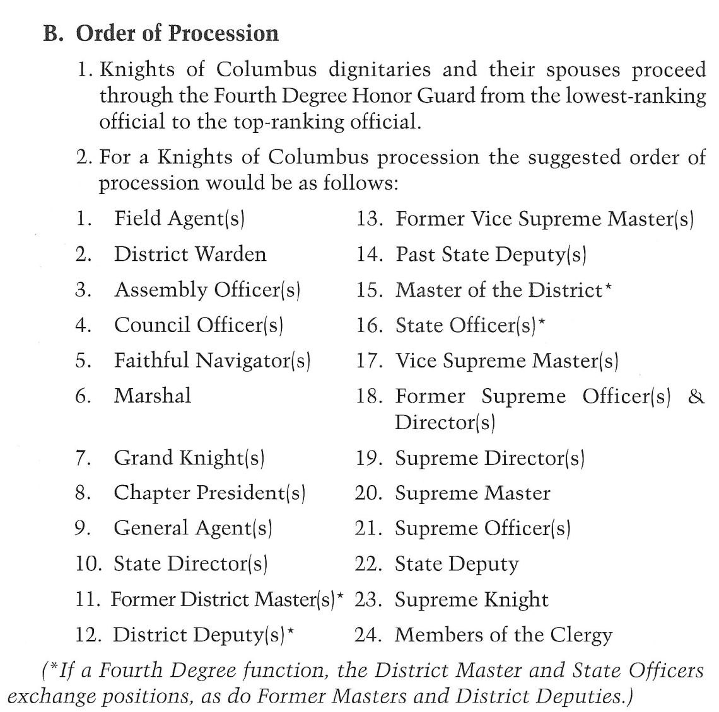
Color Corps Overview – cont.
The Provincial Marshal, District Marshal or Commander should ensure that the proper protocol for the procession into Church or a banquet hall is followed per the CC Drill Manual or Protocol Handbook

Slide 8
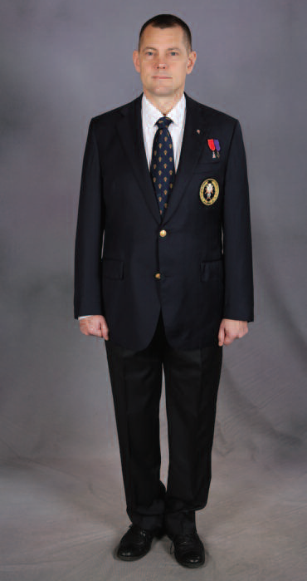
4th Degree Member Attire
Dark Gray, Navy Blue or Black Business Suit, subtle pin stripes acceptable
Plain White Full Collar or Button Down Shirt, a pin striped shirt is “NOT” acceptable
Dark Necktie
Vest optional with business suit
Black Belt or Suspenders
Black Socks and “Polished” Black Shoes
Tuxedo Jacket and Pants
Pleated Full Collar Tuxedo Shirt when worn with a tuxedo, wing tip tuxedo shirt is “NOT” acceptable
Preferably Black Studs and Black Cuff Links with tuxedo shirt only, 4th Degree studs are acceptable
Social Baldric worn over tie, when wearing suit or tuxedo
Official 4th Degree Lapel Pin PG-113 or Flag Pin
Name badge “IS NOT” to be worn when wearing the Uniform

Slide 9
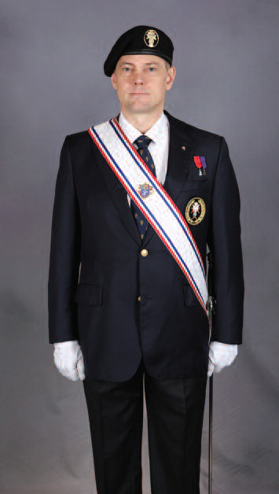
4th Degree Color Corps Attire
Official Navy Blue Blazer with 4th Degree Emblem Blazer Crest
Official 4th Degree Gray Pants, straight leg, “NO” cuffs
Official 4th Degree Necktie, (now available in extra long)
Official 4th Degree Black Beret with 4th Degree Metal Badge with appropriate color patch under badge
Plain Full Collar White Dress Shirt, Button Cuffs (no French cuffs, no button down collar or short sleeve shirt)
Black Socks and Plain Black “Polished” Shoes
Official 4th Degree Lapel Pin PG-113
Incumbent Medal of Office
Past and Former miniature medals above left pocket (1/4” above pocket)
Service Baldric and Sword
White Gloves
Name badge “IS NOT” to be worn when wearing the Uniform

Slide 10
Color Corps Appearance
The general public associates the Knights of Columbus with how the Color Corps presents themselves at events. If we look professional, then the Order is perceived as professional
Does your Uniform fit properly?
Is your beret on properly or is it the correct size?
Are your pockets empty?
Are your shoes shined?
Are you wearing clean white gloves and service baldric?
We all have an obligation to look after each other!

Slide 11
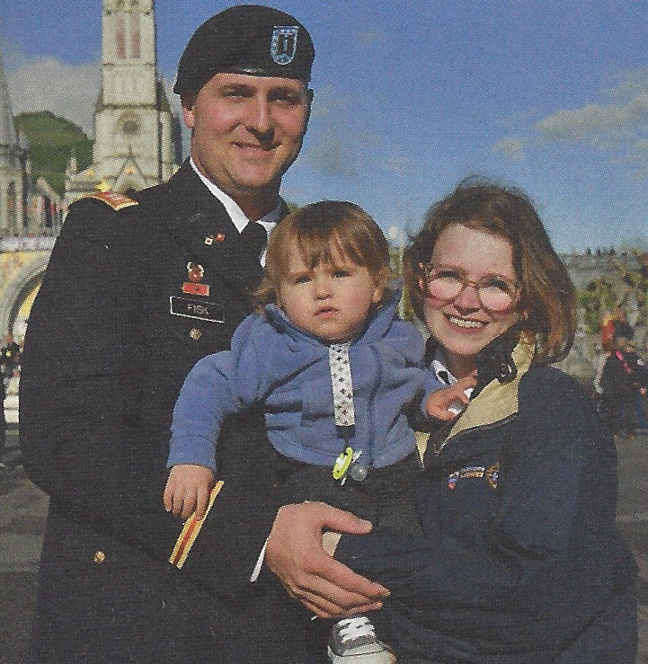
Color Corps Appearance

Slide 12
Color Corps Appearance

Slide 13
Color Corps Appearance

Slide 14
Supreme Directives
The “Classic Regalia is retired effective July 1, 2019.
The PG113 pin is the only pin allowed to be worn on the Uniform.
We obey our Priests. Any member who is refused entry into Church because he is in the Uniform should obey the Priest. The District Master should be contacted. The District Master will make the determination if the Diocesan Bishop should be contacted to discuss this incident and the refusal of the Sacraments over an article of clothing.
The “Classic or Retired Regalia” cannot be worn at a Casket Watch. The deceased may wear his “Classic Regalia” if the family so wishes.
Social Baldric is worn over the tie when wearing a suit.

Slide 15
Supreme Directives – cont.
Social baldric is never worn with the Uniform
The colored beret patch can be procured by sending an email to either: suprememaster@kofc.org or patches@kofcuniform.com stating your name, membership #, your address for the patch to be mailed to, position held, and the color of the patch needed
The beret is placed underneath the belt on the right side between the first belt loop and your pants pocket when you are not wearing it
The 4th Degree Team members should all wear the same color business suit when the robes are no longer being used. Supreme is considering sometime in the distant future that all team members will be required to wear the Uniform, but not mandatory at this time

Slide 16
Supreme Directives – cont.
Casket Watch Guidelines
When CC is present, there will not be 4th Degree member participating in the casket watch with the CC
When CC is not present, a 4th Degree member may pay respect to the deceased in pairs with like dress by standing watch at the casket in the official 4th Degree attire, tuxedo or dark suit with social baldric, no gloves
Domestic Supplier
Per the SM’s September 13th email, “they are closing in on the domestic provider for our Uniform. I am advising those who ask, to hold off on buying a uniform as I believe that you will be getting a very good deal much sooner than later. I’m sure that once we release the information our members will be happy about the price reduction and begin placing their orders”.

Slide 17
Supreme Directives – cont.
Domestic Supplier - continued
Per the SM’s October 4th memo, “Over the past two years the Order has accepted bids from several domestic companies to manufacture our uniform. Four companies submitted sample uniforms for committee consideration. Our primary concern was member cost and having the same identical fabric as our first uniforms ordered so there would be no noticeable difference in fabric, style or color. I am pleased to report that the Order has contracted with “The Supply Room.” TSR is a worldclass, leading manufacturer and distributer of military and law enforcement uniforms located in Oxford, Alabama, USA. Their executive and management staff have well over 100 years of experience and have built a solid reputation for quality, price competition and most of all, excellent customer service, and offer dedicated customer service representatives to handle only Knights of Columbus uniform orders and issues. We are certain that you will be pleased with their service, as well as the price. Our KofC web site will be updated very soon with order and contact information. I would suggest that members hold off on placing orders until we are fully operational”.

Slide 18
Supreme Directives – cont.
Domestic Supplier – cont.
Current status of the domestic supplied Uniforms
Supreme is in the process of having the current inventory picked up at their warehouse in Tennessee and brought to TSR in Alabama
All uniforms will be remeasured and prepared for shipment
Supreme’s IT department is close to having their page up and running
If anyone orders a uniform today, it would still go through the original process and at the higher price
Wait for the Supreme website to be updated and reflecting the new price before ordering the Uniform

Slide 19
Supreme Directives – cont.
Classic Regalia Infraction
Uniform Policy issued by SM in June 5, 2019 memo
FNs were notified by their District Master as to this policy
FIRST OFFENSE: Color Corpsman will be denied participation in the event and given written notification
SECOND OFFENSE: Color Corpsman will be denied participation for the balance of the year and receive a second written notification with copies to FN, VSM and SM
THIRD OFFENSE: Color Corpsman may receive a summary suspension
Master or FN that cannot comply with this policy should contact the SM
FN shall remove the CCC who refuses to follow this policy

Slide 20
Supreme Directives – cont.

Slide 21
Conditioning Your Beret

Slide 22
Conditioning Your Beret
Tie the adjustment string into a square knot once you have the correct size
Slip the string into the bead with either a pen cartridge or large paper clip
Cut out the inside lining (it will help the beret to lay correctly and keep your head cooler)
Submerge the beret in warm water so that it is thoroughly soaked
Wring out the water and place beret on your head with the stiff flap over your left eye
With your left hand, hold the left edge of the beret at ear height
With your right hand, grab the right side of the beret and pull down and stretching it over your right ear and form the beret over the top of your head
Refer to the you tube video link below: https://www.youtube.com/watch?v=LA7mYjycgFs or https://www.wikihow.com/Shape-a-Beret

Slide 23
QUESTIONS?

