Slide 1

2018
Faithful Pilot and Sentinel Training
Former Master Francesco Iannaggi

Slide 2

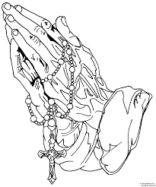
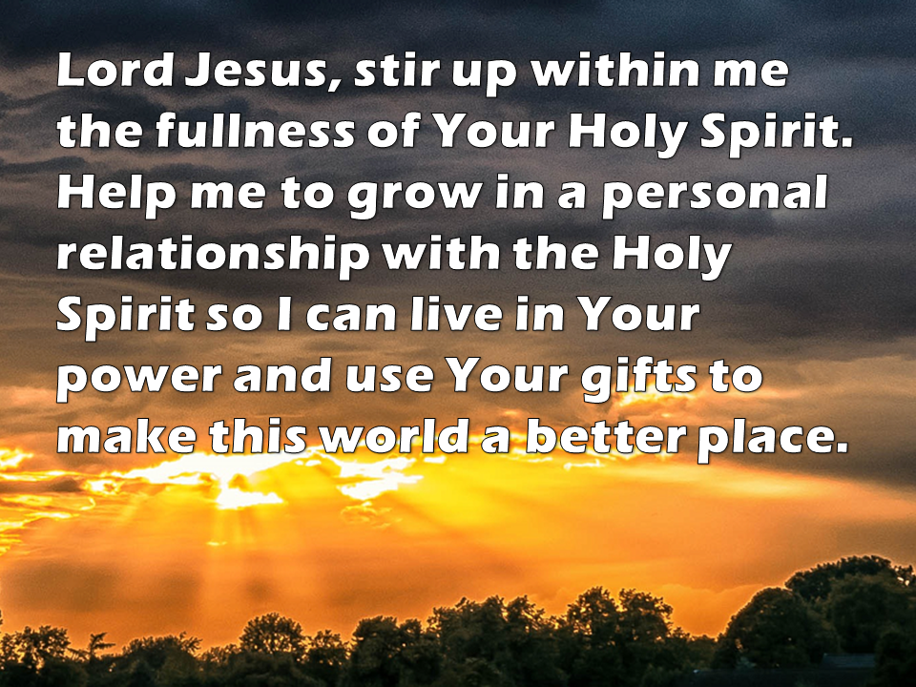
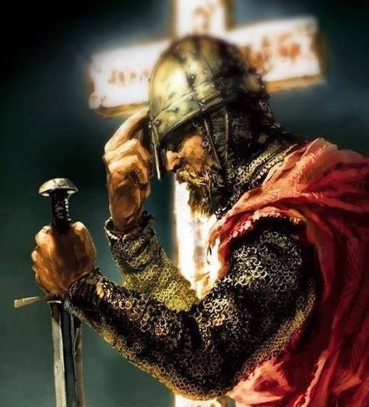
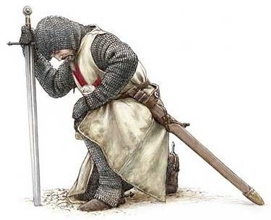
Opening Prayer

Slide 3
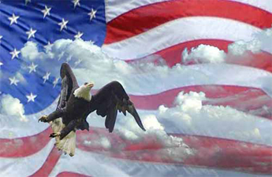
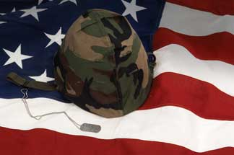


Pledge of Allegiance

Slide 4
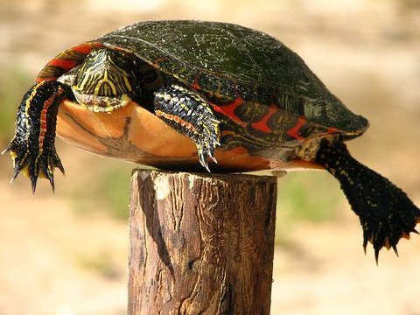
Don’t be a
Post Turtle

Slide 5

So Just what is your Job as the Faithful Pilot?
Perform the Duties of the Warden in the Third Degree Council.
Is responsible for the arrangement of the assembly chamber.
Has charge of all properties of the assembly except moneys and accounts and record books of the officers but including ceremonials.
Directs and is responsible for the activities of the Inner and Outer Sentinels.
Acquires and maintains a thorough knowledge of the policies, procedures, and protocols governing the National Flag in order to instruct the members of the Assembly, to ensure its proper care and display, and to serve as an authority on the flag for assigned councils
Is the 4th Chair Officer
Performs other duties as assigned by the Faithful Navigator

Slide 6
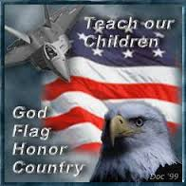
In Other Words:
The Pilot is:
The keeper of the physical property of the Assembly
The Assistant Program Director
The one who insures the Assembly Chambers are set up on time and correctly
The overseer of the Sentinels
The Flag Protocol Officer for the Assembly
Is # 4 in the Assembly Chain of Command
  Faithful Navigator
  Faithful Captain
  Faithful Admiral
  Faithful Pilot

Slide 7

The Faithful Sentinels shall:
The Faithful Inner and Outer Sentinels are specifically entrusted with the responsibility of seeing that all in attendance at an assembly function are in possession of both a Third and Fourth Degree Membership Card and so report to the Faithful Pilot.
They shall perform such other duties as may be imposed upon them by the Faithful Pilot and Faithful Navigator.
They secure the entrances to the chamber during the transaction of the business of the Assembly
The number of elected Sentinels is set as a MINIMUM of one Inside and one outside Sentinel. The Assembly may elect as many as is required to meet the security requirements of the Assembly

Slide 8
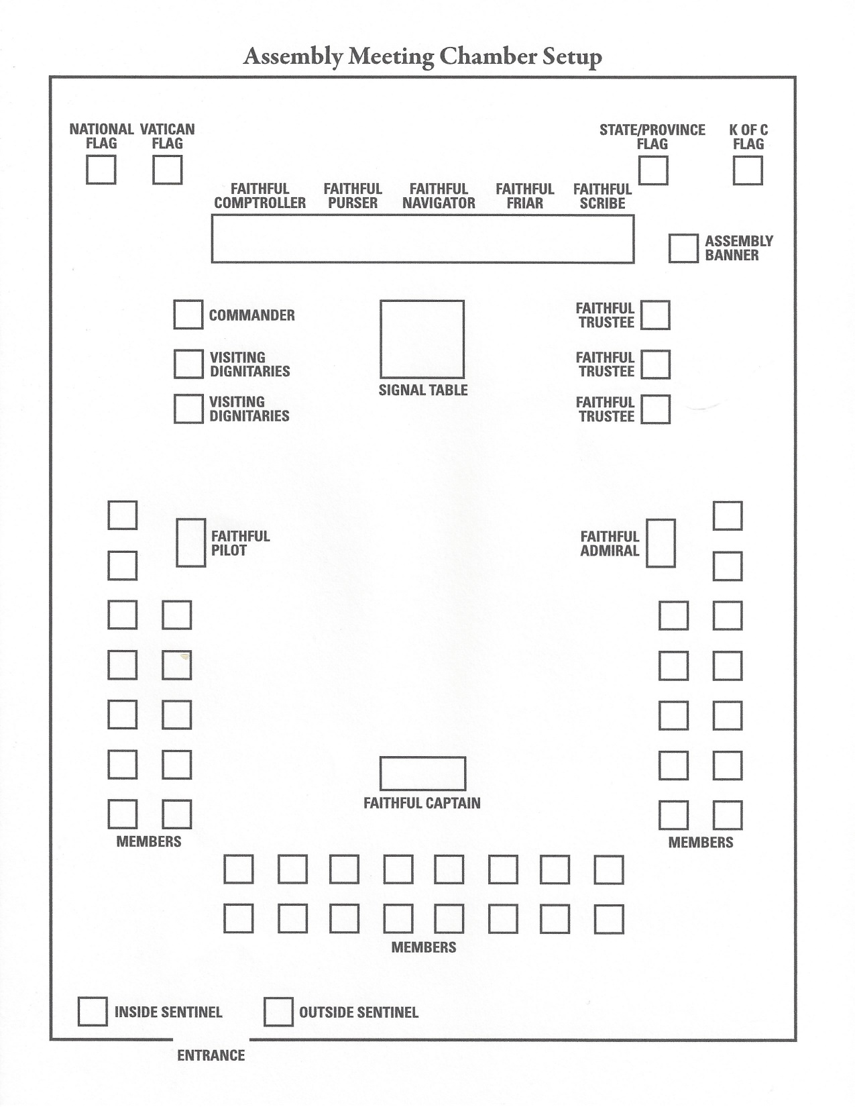
Pre Meeting
Setting up the Chamber:
  If you cannot set up the Chambers as shown then insure head table and Officers are as close to being correct as possible
  Multiple entrances require multiple Sentinels
Every person entering the Chamber shall have their 3rd and 4th Degree Cards verified
  If a known member does not have his cards (Both) this must be reported at the beginning of the meeting

Slide 9
Pre Meeting – Alternate Room Set up
USF
Faithful Navigator
ASF
Faithful Comptroller
Faithful Purser
Faithful Friar
Faithful Scribe
Work with what you have, but at all times try to maintain the essence of the Assembly Chamber set up
Name plates or tent cards showing position if not name and position work well
Remove extra chairs, stack in corner
Lectern
Faithful Commander & Dignitaries
Faithful Trustees
FS
FS
Faithful Pilot
OPEN/ Reporting Program Directors
Faithful Captain
Faithful Admiral
Members
Members
Members
Members

Slide 10
Pre Meeting- Activities
As the Pilot and Sentinels you are responsible to set up any pre meeting activities, such as, a meal, Rosary, Mass, etc.
If you have a meal/Mass etc. then the National Colors should be on display (this may require transporting the Colors to the Chamber once the activity is over as they must be in the Chamber when the Assembly is in session)
As the Pilot and Sentinels you are responsible to take down and clean up any pre meeting activities, such as, a meal, Rosary, Mass, etc.

Slide 11
During the Assembly Meeting
Pilot assumes his role as a Chair Officer with parts in the formal opening and closing of the Meeting. These parts should be memorized and recited from memory.
Sentinels will assume there positions at the door(s) of the Chamber and control flow into and out of the Chamber at all times
  Remember that no one not fully qualified as a Fourth (Patriotic) Degree Brother may enter the Chamber during the Assembly Business Meeting without the expressed permission of the Faithful Navigator.
  Sentinels are also to serve as the Sergeant at Arms and insure unruly individuals are removed from the Chamber at the direction of the Faithful Navigator

Slide 12
Post Meeting Duties
The Faithful Pilot and his Sentinels are responsible for
returning the Chambers to the set up prior to the meeting with all chairs and tables back in position
Gathering all Assembly property and storing it properly
  One Sentinel should be assigned to collect all the Assembly’s Officer Jewels and storing them
  One Sentinel should be assigned to pick up all the trash and sweep the floor as required
Insuring all lights are off

Slide 13
Care of Assembly Property
The Pilot is the Care taker of all the Assembly property
The Pilot should at least annually inventory all property
  This includes items for pre meeting meals and alike
  This includes all certificates and files
The Pilot is the keeper of all memorial items
  This includes Chalices, Memorial Plaques and books,
The Pilot is the keeper of all donated Regalia items
The Pilot must report to the Faithful Navigator at least annually the status of the Assembly equipment

Slide 14
Final Thoughts
The Faithful Pilot is the 4th Chair Officer and as such is an important Officer in the Assembly.
No one should accept the Pilot’s position unless they are willing to follow the normal succession plan:
  Pilot to Captain to Navigator to Admiral to Trustee
  It is not a position for life and should not be held for more than two terms
The Sentinel position is the first of the Officer positions, here you learn about the functioning of the Assembly and Sentinels should seek to advance to higher positions in the Assembly Officer Corps in due time

Slide 15
Know your Job and do not be afraid to ask questions and offer suggestions for improvement
Don’t be a
Post Turtle

Slide 16
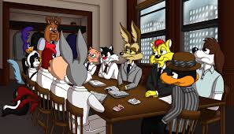
?Questions?

