Slide 1
Marshals and Commanders
Training
Former Master Robert Vandesteene
October 13, 2018

Slide 2

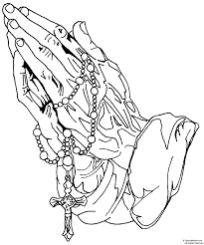

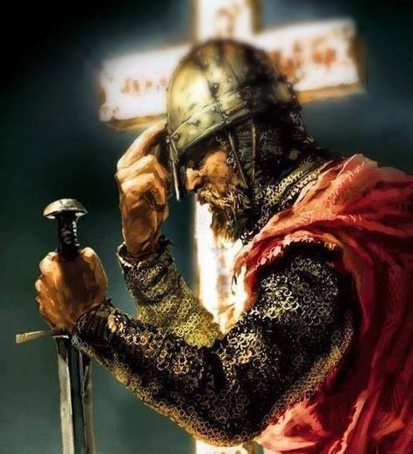
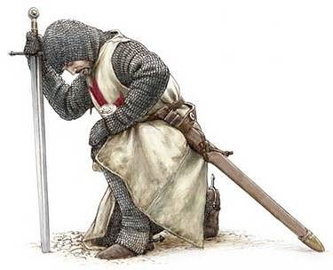
Opening Prayer

Slide 3

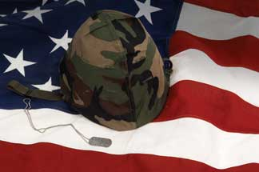


Pledge of Allegiance

Slide 4
What We Will & Won’t Talk About Today
Duties & Role of the Marshal and Color Corps Commander
Establishment and Development of the Assembly/District Color Corps
Official Regalia Of the Fourth Degree
Inspection of the Color Corps/Honor Guard
Color Corps Training
Train the Trainer
Questions
We will not discuss or debate the merits of the new Fourth Degree Uniform

Slide 5
Duties and Job Descriptions
Marshals:
Laws and Rules Governing the Fourth Degree of the Knights of Columbus Article VX Section 17 paragraph (l)
“The Master may appoint one or more Marshals to assist him at the “Installation of Officers” and other activities”
The District Marshal shall obtain his own Sword, Service Baldric, White Gloves and Uniform
The District Marshal serves at the pleasure of the Master for the District, and The Marshal’s Term shall not exceed the Term of Office of the Master for the District
The District Marshal shall be in command of the District Color Corps/Honor Guard
Whenever two or more Assemblies are assigned by the Master for the District The District Marshal shall be in Command – (When multiple Assemblies join as guests of a single Assembly, the Host Assembly Commander is in Command) (Funerals etc.)

Slide 6
Duties and Job Descriptions
Marshals:
The District Marshal shall provide Training for the District’s Assemblies Commanders and their Color Corps/Honor Guards in accordance with the Color Corps Manual and the Direction of the MFD and VSM
The District Marshal shall appoint and have command over District Sentinels at District Functions. (Exemplifications and District Meetings and as directed by the MFD)
The District Marshal shall assist the District Master when inspecting the District/Assembly Color Corps/Honor Guard
The District Marshal is a member of the District Exemplification Team
The District Marshal shall meet with the presiding Priest prior to any participation in any Liturgical event. (Mass, Communion, Confirmation, and Weddings as examples)
At Provincial events District Marshals are under the Command of the Provincial Marshal
The District Marshal shall preform all other Duties as assigned by the MFD

Slide 7
Duties and Job Descriptions
Provincial Marshal(s):
The Provincial Marshal(s) is appointed by the Vice Supreme Master and his term shall not exceed that of the Vice Supreme Master
When two or more Districts are assigned to an event the Provincial Marshal is in Command. (When multiple Districts are participating as guests of a single District, the Host District Marshal is in Command)
The Provincial Marshal shall train District Marshals as to the duties and functions of the Color Corps/Honor Guard in accordance with the Color Corps Manual and the Direction of the VSM
The Provincial Marshal shall command the Color Corps/Honor Guard at Provincial Meetings
The Provincial Marshal shall preform all other duties as assigned by the VSM

Slide 8
Establishment of the Assembly Color Corps
ARTICLE XII COLOR CORPS Section 41.
The Establishment of:
Assembly may henceforth establish a uniform drill corps with the approval of the Master of the District and such unit shall be known as "Fourth Degree Color Corps of __________ Assembly."
A Color Corps may participate in exemplifications, religious and public functions only with the consent of the Master. The Master shall have full control of the Color Corps in his district, except as hereinafter provided and shall be held strictly accountable for such unit.
The Faithful Navigator shall appoint a Commander of the Color Corps for his Assembly. One and only one Commander shall be appointed.

Slide 9
Duties and Job Descriptions
Assembly Commander:
The Assembly Commander is appointed by and serves at the pleasure of the Faithful Navigator to command the Assembly Color Corps in accordance with the Laws and rules of the Fourth Degree of the Knights of Columbus, the Color Corps Drill Manual and the direction of the Master for the District and the Vice Supreme Master
The Assembly Commander is in command of the Assembly Color Corps/Honor Guard
The Assembly Commander is responsible for the Training, and actions of the Assembly Color Corps/Honor Guard
The Assembly Commander shall enforce all Supreme, Provincial, and District Directives as to the Assembly Color Corps/Honor Guard to include but not limited to participation in Liturgical events, Drill and Ceremonies, and the Fourth Degree Uniform

Slide 10
Duties and Job Descriptions
Assembly Commander:
The Assembly Commander shall inspect the Assembly Color Corps/Honor Guard prior to each and every event. Those found out of uniform, or whose uniform does not conform to the Supreme Directives shall retire from the ranks.
The Assembly Commander shall meet with the presiding Priest prior to any participation in any Liturgical event. (Mass, Communion, Confirmation, and Weddings as examples)
The Assembly Commander shall not appoint, “Lieutenant Commanders” or any other such designation.
If the Assembly Commander can not be present at an event, the Faithful Navigator shall take Command if both are absent the Faithful Admiral takes command, if all three are absent the Faithful Captain Takes Command, then the Faithful Pilot and if none are present a Trustee shall take command. If none named can be present the event shall be cancelled. (This includes standing Honor Guard at a Brother’s Wake)

Slide 11
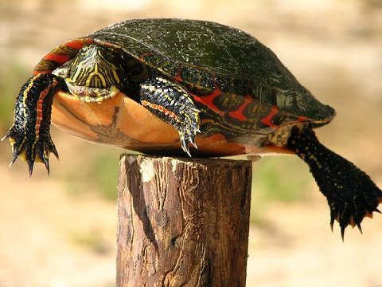
Establishment and Development of the Assembly/District Color Corps
Don’t be a
Post Turtle

Slide 12
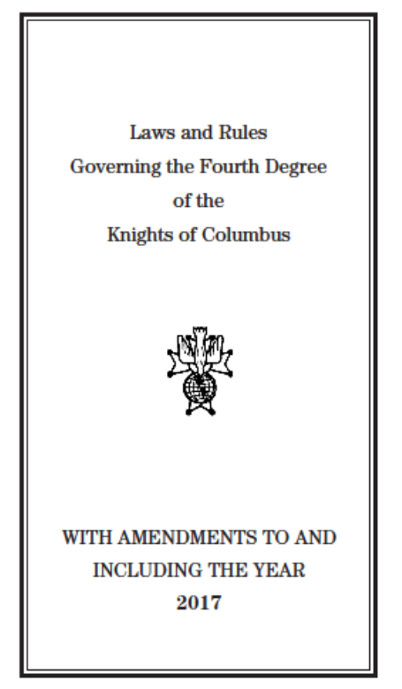
Establishment and Development of the Assembly/District Color Corps
Get a Copy
Read & Study
&

Slide 13
Establishment and Development of the Assembly/District Color Corps
ARTICLE XII
COLOR CORPS
Section 41. The Establishment of:
(a) Assembly may henceforth establish a uniform drill corps
with the approval of the Master of the District and such unit
shall be known as "Fourth Degree Color Corps of __________
Assembly."
(b) A Color Corps may participate in exemplifications, religious
and public functions only with the consent of the Master.
The Master shall have full control of the Color Corps in his district,
except as hereinafter provided and shall be held strictly
accountable for such unit.

Slide 14
Establishment and Development of the Assembly/District Color Corps
ARTICLE XII
COLOR CORPS
Section 42. Procedure and Manual of the Sword.
The procedure and Manual of the Sword shall be in accordance
with the “Color Corps Drill Manual.” In the absence of
such directive the District Master has full control provided,
however, that he first receives approval of such procedure from
the Supreme Master.

Slide 15
Purpose and Description of the Color Corps of the Fourth Degree
The primary purpose of the Fourth Degree is to encourage active
Catholic citizenship and foster the spirit of patriotism in members and the
community at large.
The Color Corps members exemplify all the principles of our Order:
• Charity - by the gift of their time and energies necessary to practice,
perfect and perform the ceremonials and sword drill;
• Unity – by the united efforts of Sir Knights to practice and perfect a
coordinated drill for the good of the Church and the Order;
• Fraternity – by expressing an “Esprit de Corps,” sharing a common
desire for drill excellence and camaraderie; and
• Patriotism – by performing precision drill as a salute to God and to
country and visually exhibiting a love for both.

Slide 16
Purpose and Description of the Color Corps of the Fourth Degree
The Color Corps (C.C.) has two sub-groups, the Color Guard (C.G.) and the Honor Guard (H.G.).
The Color Guard consists of the flag bearers and at least two members of the Honor Guard who escort the colors.
The Honor Guard consists of members of the Color Corps who have mastered
the Manual of the Sword.
In many assemblies, all members of the Color Corps belong to the Honor Guard. This should be kept in mind when following the procedures in this manual.
The public appearance of Fourth Degree Knights as a Color Corps at religious and civic functions is an important activity for each assembly.
They add dignity and the pride of Church and country to any event. By these public demonstrations their loyalties bring credit to themselves and to the Knights of Columbus.

Slide 17
Establishment and Development of the Assembly/District Color Corps
Every assembly should organize and maintain a Fourth Degree Color Corps under the supervision and direction of the Master of the District.
Such bodies may participate in Installation of Officers, Fourth Degree Exemplifications, religious and public functions and parades and other functions, with consent of the Master of the District.
The training and activities of an assembly’s Color Corps should be coordinated and directed by a Color Corps Commander to be appointed by the Faithful Navigator.
It is important to remember that when individual members of the Color Corps appear at public functions they are not only representing themselves, but also their assembly and the entire Order of the Knights of Columbus. Their conduct and appearance should reflect this at all times.

Slide 18
Establishment and Development of the Assembly/District Color Corps
The regulations for the Color Corps apply to the following:
Color Corps: A Fourth Degree Knight, who has been trained and possesses the official regalia, in good repair, is eligible to participate in Color Corps functions.
The assembly will have a Color Corps Commander appointed by the Faithful Navigator for a term not to exceed that of the Faithful Navigator.
The Marshal/Color Corps Commander is responsible for securing his own sword, service baldric and gloves.
Expenses incurred by the Assembly Color Corps are the responsibility of the Assembly and are not chargeable to the fund of the District Master

Slide 19
Establishment and Development of the Assembly/District Color Corps
5. The Master For the District must contact the Ordinary of the Diocese as to his wishes pertaining to the C.C. in liturgical events.
6. The pastor of a church must also be consulted, and his approval obtained, before any function can take place in his parish. Please note: the policies as approved by the
Ordinary for the Color Corps will ALWAYS take precedence.
7. The Marshal is the Commander in charge at any district or provincial event where he is acting on behalf of the Master for the District.
8. The Color Corps may not cross District lines except with the approval of the Master for the District’s involved and have received approval of the Vice Supreme Master(s)
9. For a multi-assembly function, when all Color Corps members are invited to participate, the Master for the District, through his Marshal, will be in charge.

Slide 20
Establishment and Development of the Assembly/District Color Corps
10. For Supreme Council functions, where Color Corps members come from Order wide jurisdictions, the Color Corps will be under the direction of the host Vice Supreme Master with support from the hosting Master for the District and his Marshal.
11. The assembly Color Corps may perform at any internal or external function
in its designated service area and shall be under the direction of the Assemblies Faithful Navigator through the Color Corps Commander.

Slide 21
Establishment and Development of the Assembly/District Color Corps
Who can be a member of the Assembly Color Corps/Honor Guard?
Any Brother who is a Fourth Degree Knight in good standing, who has the proper uniform and equipment may be a member of his Assembly’s Color Corps/Honor Guard

Slide 22
Official Regalia Of the Fourth Degree
New Official Regalia Dress
Full Implementation on 1 July 2019
After 1 July 2019 the “Old” Regalia is no longer authorized and is not to be worn
Supreme has indicated that there will be no further delays or extensions of the implementation date
Supreme is seeking additional manufacturers to make the new Regalia, these will include manufacturers in the USA

Slide 23
Official Regalia Of the Fourth Degree
Official Regalia Dress – Members
The officially designated Fourth Degree member regalia dress is set forth in the Laws of the Fourth Degree (Article XI, “Official Dress and Regalia,” Sections 38 and 40); and is as follows:
Navy Blue Blazer with Fourth Degree Emblem Crest and Knights of Columbus Emblem of the Order buttons
Official Fourth Degree Gray trousers
Official Fourth Degree Necktie
Official Fourth Degree Black Beret with Fourth Degree metal badge
Plain White Dress Shirt with button cuff (no French cuffs – no button down collar shirts)
Plain Black trouser belt
Black Socks and Plain Black Shoes
Official Fourth Degree Lapel Pin (#PG-113)
Past and Former Miniature Medals of Office

Slide 24
Official Regalia Of the Fourth Degree

Slide 25
Official Colors of the Fourth Degree
The colors for the Fourth Degree Color Corps are set forth in the Laws of the Fourth Degree, Article XI, are designated to be worn directly behind the Fourth Degree Medal Badge affixed to the Official Color Corps beret,
and colors are designated as follows:
Supreme Master & Former Supreme Master
Dark Blue Cloth Backer Pantone # 19-4035 TC
Vice Supreme Master & Former Vice Supreme Master
Light Blue Cloth Backer Pantone # 14-4313 TC
District Master & Former District Master
Gold Cloth Backer Pantone # 13-0941 TC
Marshal
Green Cloth Backer Pantone # 18-5315 TC
Faithful Navigator & Past Faithful Navigator
White Cloth Backer Pantone # 11-0601 TC
Assembly Commander
Purple Cloth Backer Pantone # 19-3542 TC
Member
Black Beret with Fourth Degree Medal Badge with no backer
Backers are to be ordered through the Supreme Master’s Office

Slide 26
Official Regalia Dress – Color Corps
The Knights of Columbus Color Corps official regalia dress is the same as the official regalia dress of a member, with the addition of the following:
Service Baldric, together with a sword, worn over the blazer front from the right shoulder to the left hip. When a sword is not permitted for any reason the Service Baldric shall be worn nevertheless.
White gloves
Color bearers wear a color bearer harness and the Service Baldric with no sword

Slide 27
Official Regalia Dress – Color Corps

Slide 28
Official Regalia Dress – Color Corps
When a Fourth Degree member attends an official function of the Order where Fourth Degree dress is required (whether member regalia or Color Corps regalia), he may wear the current medal of his office around his neck, Assembly, Council, State Council, Supreme Council or Supreme Assembly.
At a Fourth Degree exemplification the only lapel pin allowed is the Official Knights of Columbus Fourth Degree Lapel Pin (#PG-113).
For Fourth Degree exemplification attire for members, candidates and military, refer to Official instructions.
A Former Supreme Director, Past State Deputy, Former Vice Supreme Master, Former District Master, Former District Deputy, Past Grand Knight or Past Faithful Navigator may wear their Past and Former Miniature Medal for offices held No other medals other than Papal Medals, may be worn, upon the Official Blazer.
A pocket name badge is not worn with Member or Color Corps regalia

Slide 29
Inspection of the Color Corps/Honor Guard
When:
Prior to every assignment
Twice a year after District Exemplifications when new members join the Color Corps
At annual recertification
Who performs the Inspection:
Assembly
The Faithful Navigator with the Color Corps Commander
District
  The Master with the District Marshal
Province
The Vice Supreme Master with Provincial Marshal and District Masters (District Marshals may participate at the direction of the Vice Supreme Master)

Slide 30
Inspection of the Color Corps
Why:
  To insure the Color Corps complies with the Supreme Guidelines
  To insure the uniform is worn correctly
  To insure the Color Corps is Uniform
How:
  Color Corps to form in Ranks
  Ranks to Dress Right at a full Arms Length
  Ranks to preform “Open Ranks” to allow inspectors to pass though the Ranks
  Each member of the Inspection party will Halt in front of each member of the Color Corps execute a facing movement to stand face to face to perform the inspection.
  The inspectors shall view the rear of the uniform as they move between the ranks. If corrections are to be made, a Marshal or Color Corps Commander will return to the front of the inspectee to make the correction known

Slide 31
Order of Line up
How to line up when Brother Sir Knights wearing New and Old Regalia are present:
New Regalia to the front by Rank, then the Old Regalia by Rank
Remember after 1 July 2019 that members wearing the “Old” Regalia may not participate

Slide 32
Color Corps Training
Who is Responsible for the Training and performance of the District/Assembly Color Corps?
The Master for the District is ultimately for the Training and Performance of the District Color Corps/Honor Guard
The Faithful Navigator is ultimately for the Training and Performance of the Assembly Color Corps/Honor Guard
The District Marshal shall train and supervise the performance of the District Color Corps/Honor Guard as directed by the Master for the District

Slide 33
Train the Trainer
Teaching Styles:
Authority:
  This style is traditional and didactic.
  Conveys facts that the teacher thinks the learner needs to know and may answer questions but only relating to what’s been said.
  Likened to a parent and child relationship.
Motivator:
  Less didactic
  Based on questions and answers but it is still the teacher’s agenda.
  The teacher gives new facts but only when the learner shows they don’t know.
  Thus is still teacher driven although more learner centered and supportive.
  Can motivate the interested learner to learn and at some stage move onto more independent learning.

Slide 34
Train the Trainer
Teaching Styles:
Facilitator:
  More facilitating along the line of “Find out for yourself.”
  Teacher happy to share information and knowledge
  Recognizes that each party knows some things but not necessarily the same.
  Sharing approach good for training.
Delegator:
  Discussion between equals
  As if the teacher holds up a mirror, helping the learner to understand what the problem is, and to look at relationships and communication.
  Acts as a consultant when needed
  Mainly happy to delegate to the individual their self directed learning.

Slide 35
Train the Trainer
Learning Styles:
Activists:
  Activists immerse themselves fully and without bias in new experiences, enjoying the moment.
  They are enthusiastic and open-minded and thrive on a new challenge.
  They like brainstorming and will act without thinking through the outcomes.
  They get bored easily and may struggle to follow a project through to completion.
Reflectors:
  Reflectors listen to others, analysing the content of the conversation before contributing their own input.
  Reflectors therefore need time to think through the options and will not give an immediate answer to questions.
  They tend to be cautious, thoughtful people and consider the wider picture when arriving at decisions.

Slide 36
Train the Trainer
Learning Styles:
Theorists:
  They like basic assumptions, principles, models, systems and theories on which to base their experiences.
  They like to think through their problems on a step by step basis to analyse and synthesise information.
  They like objectivity rather than subjective judgements.
Pragmatists:
  Pragmatists like trying out ideas, theories and techniques to see if they work in practice.
  They can be impatient to get on with things and act quickly and confidently on things that appeal to them.
  They are practical, down to earth people who like solving problems.

Slide 37
Train the Trainer
Learning Stages:
Learners tend to go through stages as they progress and in due course develop an increasing amount of self direction
Dependent
Interested
Involved
Self directed

Slide 38
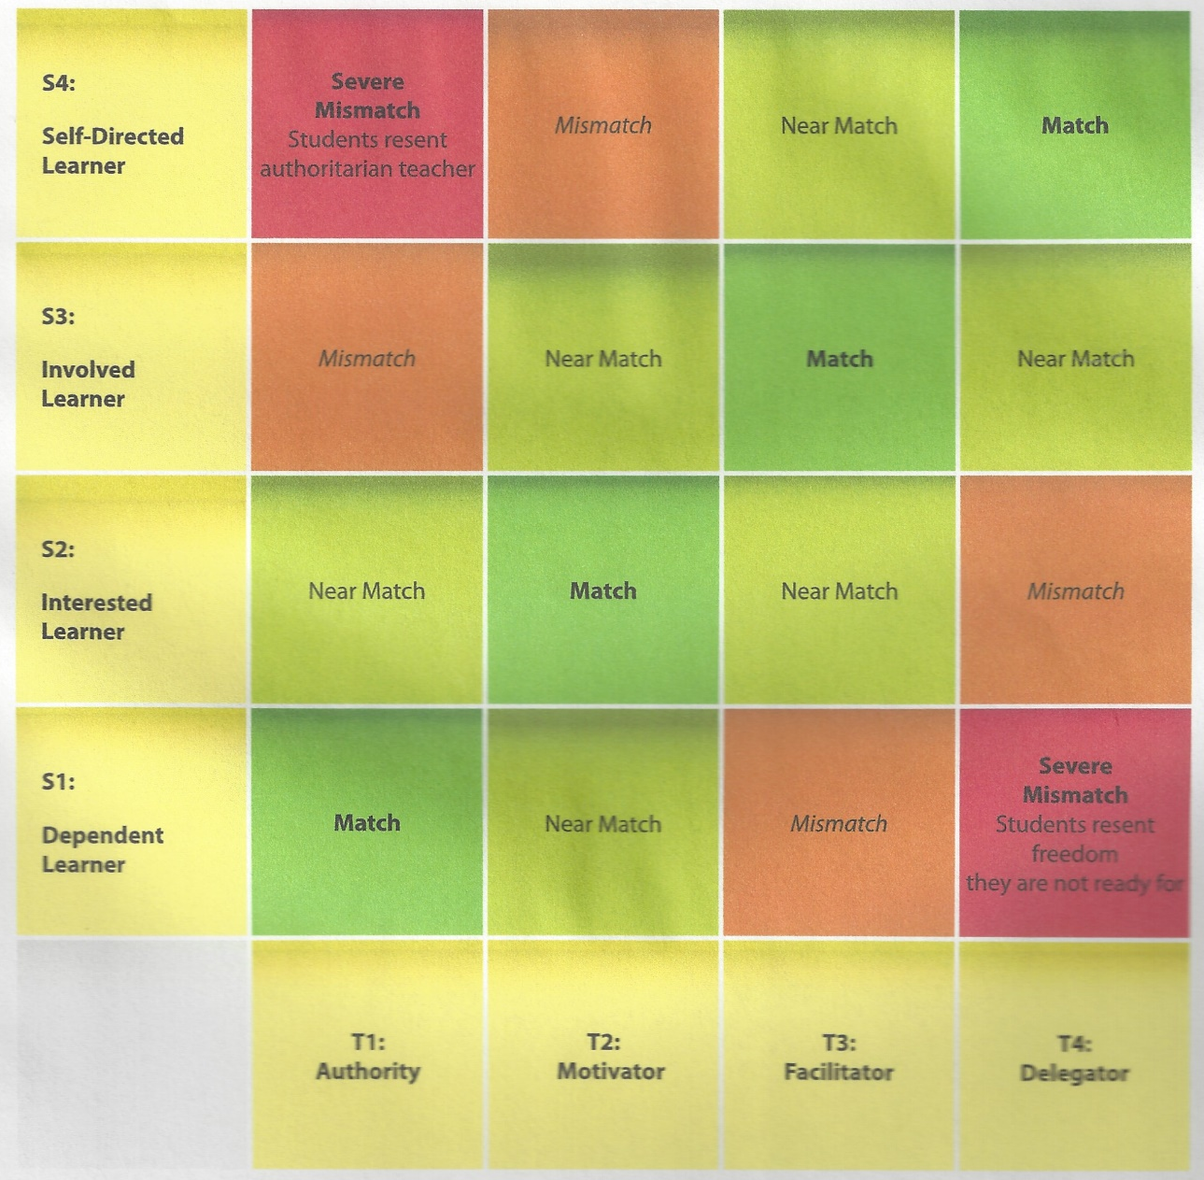
Train the Trainer
In this model, teachers adapt their teaching styles to match the student’s stage of learning and degree of self direction, and in order to increase that self-direction.
Problems occur when dependent learners are mismatched with non-directive teachers and when self-directed learners are mismatched with highly directive teachers.
L
E
A
R
I
N
G
S
T
A
G
E
Teaching Style

Slide 39
Train the Trainer
The five principles of human learning
Trainers can help facilitate successful training events by remembering:
1 A learning activity should be goal-directed
2 People learn what they practice
3 Learning is built upon the foundation of the previous step
4 Learners must make a personal connection
5 Activity and interest must be high

Slide 40
Train the Trainer
Ten characteristics of adult learners
Teaching adult learners carries its own specific challenges. Generally speaking, adult learners...
1 Must see the purpose and benefits
2 Need positive reinforcement
3 Must practice to retain information
4 Associate new skills with past experiences
5 Engage in learning that helps them cope with life changes
6 Require clear expectations
7 Demand comfort and breaks
8 Need to see successful application of tasks
9 May be impatient and want to “move on”
10 Can be quick to evaluate good teaching

Slide 41
Train the Trainer
Principles of adult learning
Practicality
  Activities should be practical and “hands-on”. Experience (including mistakes) provides the basis for the learning activities. Since many adults are more self-directed, instruction should allow learners to explore the practical application of knowledge, with the instructor providing guidance when mistakes are made.
Relevance
  Adult learners need to know “what’s in it for me?” Adults are most interested in learning subjects that have immediate relevance and impact to their job or personal life. With adult learners, you may need to explain the reasons specific things are being taught.

Slide 42
Train the Trainer
Principles of adult learning
  Past Experience Adult learners (as well as the instructor) should tap into the experiences of other learners. Adult learners have a wide range of background experience and abilities. Teaching approach and activities should allow for different levels and types of previous experience.
Task-oriented
  Adult learning is problem-centered rather than content oriented. Instructors should facilitate, not just deliver knowledge. Adult learners need clear objectives. Instruction should be task-oriented, with learning activities placed in the context of common tasks that the learners will perform.

Slide 43
Train the Trainer
Five Step Teaching Method
Tell
Show
Hands-on
Review
Elicit Questions
Using all five steps in your training session is an excellent way to encourage structure in your training plan and improve knowledge retention among trainees.

Slide 44
Train the Trainer
Five Step Teaching Method
Tell
Objectives:
  Clearly explain the objectives and benefits of the system for each course, using proper terminology - what will you teach?
Purpose:
  Tell trainees why they are doing things, and how the training will it help them do their job and/or make the job easier - why does the trainee need to learn this?
Expectations:
  Set expectations for yourself and trainees - how will you teach, and how will they learn? Show

Slide 45
Train the Trainer
Five Step Teaching Method
Show
Use multiple methods to visually instruct the trainees.
Use the projector and PowerPoint™ presentations, video presentations and or assistant instuctors to demonstrate each module’s teaching points for the trainees.
Walk through each lesson and give trainees reference page numbers in The Color Corps manual and time for note taking when possible.
Demonstrate and explain what you are doing, as you do it.

Slide 46
Train the Trainer
Five Step Teaching Method
Hands-On
Set up and conduct hands-on exercises for your trainees.
  Hand-on experiences results in the highest level of information retention.
Whenever possible, keep the trainee/equipment ratio low
  That way all trainees will have time to practice with an Instructor.
Hold trainees accountable
  Keep them on task
  when working in teams, ALL trainees share responsibility.

Slide 47
Train the Trainer
Five Step Teaching Method
Review
Review the objectives, purpose, process steps, and key points.
Review sessions are helpful for smooth transitions between lessons and help trainees focus on the most important information being presented.

Slide 48
Train the Trainer
Five Step Teaching Method
5. Questions
Use positive reinforcement,
Encourage discussion and questions,
Facilitate participation by asking questions of the group.
To help the class run more efficiently, encourage trainees to write down any questions not appropriate to the lesson being discussed (the “parking lot” method) and direct discussion of those questions to a designated person at the end of the presentation.

Slide 49
Train the Trainer
  Remember who you are and who you represent
    As a Marshal you represent the Master for the District
    As Color Corps Commander you represent the Faithful Navigator
    You represent the Vice Supreme Master as well as the Supreme Master
  Dress accordingly (Looking sharp gives the initial impression you know what you are doing)
    Ideal will be to conduct Training at all levels in your Regalia
    Second best in sport coat and tie (Marshals should always wear their Jewel)
    NEVER in Shorts and tee shirts
  Know your subject well
    Practice Practice Practice
    Cannot teach if you cannot do and do not know your subject
  Answer questions to the best of your ability
    Do not be afraid to simply say “I do not know”

Slide 50
Train the Trainer
Giving Commands:
Two types of Commands , Silent and Verbal
All Commands have two parts
Verbal Commands must be clear and loud so all may hear and understand

Slide 51
Train the Trainer
Giving Commands:
Two types of Commands , Silent and Verbal
  Silent or Visual commands. Due to the necessity for silence, particularly during a drill participation in church,silent “cues” must be used by the Color Corps Commander or Marshal to instruct members and to give commands.
  The simplest method for those visual commands is for the Color Corps Commander or Marshal. to step to a position where he is visible to all of the Sir Knights participating and give the cue for the order he wishes carried out.
  For example - raise both hands, palm up, from the sides to order the Honor Guard to Stand; or
  Place right hand on the grip of the sword to order “DRAW,” place right hand on the grip of the sword, to complete the order he will draw his sword out about 6 inches, hold 5 to 10 seconds & then complete
  It is absolutely essential that the Color Corps practice with silent commands be conducted so all members of the Honor Guard will be familiar with the “cues” and the required responses.

Slide 52
Train the Trainer
Giving Commands:
Two types of Commands , Silent and Verbal
All Commands have two parts
  The first part is the Preparatory Command and the second is the Execution Command
  The Preparatory Command alerts the unit that a command is coming i.e. “Assembly” or Color Corps, or Color Guard”
  The second portion is the Execution Command and tells the unit what to do i.e. “ Attention, Stand at ease, Draw swords, etc.
    Sample Commands:
      “Color Guard DRAW” “SWORDS”
      “Assembly ATTEN” “SHUN” not “tin-hut”
      “Color Guard PRESENT” “the COLORS”

Slide 53
Train the Trainer
Order of Procession
Knights of Columbus dignitaries and their spouses proceed through the Fourth Degree Honor Guard from the lowest-ranking official to the top-ranking official.
For a Knights of Columbus procession the proper order of procession is as follows:
1. Field Agent(s) 13. Former Vice Supreme Master(s)
2. District Warden 14. Past State Deputy(s)
3. Assembly Officer(s) 15. Master(s) of the District*
4. Council Officer(s) 16. State Officer(s)*
5. Faithful Navigator(s) 17. Vice Supreme Master(s)
6. Marshal 18. Former Supreme Officer(s) & Director(s)
7. Grand Knight(s) 19. Supreme Director(s)
8. Chapter President(s) 20. Supreme Master
9. General Agent(s) 21. Supreme Officer(s)
10. State Director(s) 22. State Deputy
11. Former District Master(s)* 23. Supreme Knight
12. District Deputy(s)* 24. Members of the Clergy
(*If a Fourth Degree function, the District Master and State Officers exchange positions, as do Former Masters and District Deputies.)

Slide 54
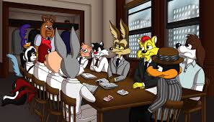
?Questions?

